Slide 1
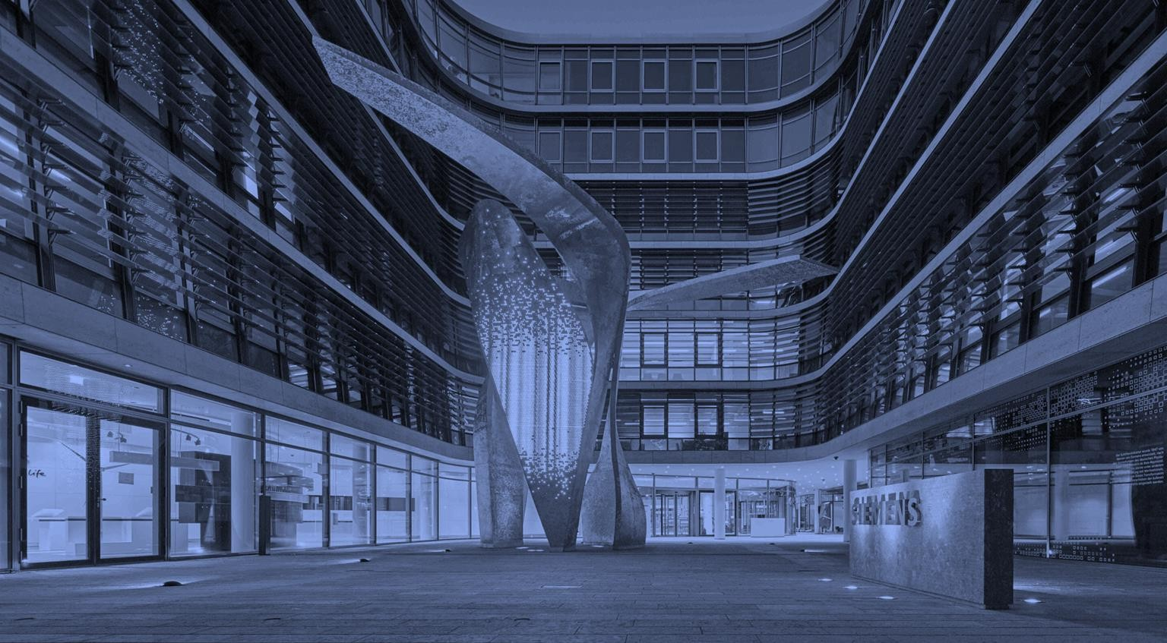
Gales, Gigawatts, & Green Energy: Shaping Our Planets Future Through Alternative Energy
Auburn Tigers
Jack Perkins | Jameson Fecteau Lauren Rutherford | Wesley Lowman
Harbert College of Business, Auburn University Auburn, March 12th, 2023

Slide 2

Table of Contents
Executive Summary
Industry Analysis
Company Overview
4
6
11
Siemens
Vestas
III. Strategic Fit
III. Financial Analysis
30
Comps
Discounted Cash Flow
III. Synergies
IV. Acquisition Feasibility
49
57
68
Alternative Solution
Conclusion Appendix Bibliography
Executive _{S}S_{u}u_{m}m_{m}m_{a}a_{ry}ry
Industry _{A}A_{n}n_{a}a_{ly}ly_{s}s_{is}is
Company O_{O}v_{v}e_{e}r_{r}v_{v}i_{i}e_{e}w_{w}
Financial O_{O}v_{v}e_{e}r_{r}v_{v}ie_{ie}w_{w}
Feasibility A_{A}n_{n}a_{a}ly_{ly}s_{s}is_{is}
Alternative S_{S}o_{o}lu_{lu}ti_{t}o_{io}n_{n}
Conclusion
2

Slide 3
Table of Abbreviations
Abbreviation | Explanation
ABL | Asset-Based Loan
AG | Aktiengesellschaft
AI | Artificial Intelligence
APAC | Asia Pacific
Bn | Billion
BTM | Back of the Meter
C&I | Commercial and Industrial
CAGR | Compound Annual Growth Rate
CapEx | Capital Expenditures
CCUS | Carbon Capture, Utilization, and Storage
CFO | Cash From Operations
CNMV | Comisión Nacional del Mercado de Valores
D&A | Depreciation and Amortization
DCF | Discounted Cash Flow
DI | Digital Industry
DKK | Danish Krone
DoE | Department of Energy
EBIT | Earnings Before Interest and Tax
EBITDA | Earnings Before Interest, Tax, Depreciation, and Amortization
EBT | Earnings Before Tax
EMEA | Europe, Middle East, and Africa
EPS | Earnings Per Share
ESaaS | Energy Software as a Service
Etc. | Et Cetera
EU | European Union
EV | Electric Vehicle
EV | Enterprise Value
FCF | Free Cash Flow
FTM | Front of the Meter
FX | Foreign Exchange
FY | Fiscal Year
GDIP | Green Deal Industrial Plan
GDP | Gross Domestic Product
GW | Gigawatt
Abbreviation | Explanation
H₂ | Dihydrogen
HVAC | Heating, Ventilation, and Air Conditioning
ICE | Internal Combustion Engine
IoT | Internet of Things
IRA | Inflation Reduction Act
ITC | Investment Tax Credit
JV | Joint Venture
kWh | Kilowatt Hour
LIBOR | London Interbank Overnight Rate
LTM | Last Twelve Months
M&A | Mergers and Acquisitions
_{M}3 | Cubic Meters
MM | Million
MO | Mobility
MSCI | Morgan Stanley Capital International
MW | Megawatts
NOPAT | Net Operating Profit After Tax
PE | Price to Earnings
PP&E | Property, Plant, and Equipment
PTC | Production Tax Credit
PV | Photovoltaic
R&D | Research and Development
SFS | Siemens Financial Services
SHL | Siemens Healthineers
SI | Smart Infrastructure
T | Total
TAM | Total Addressable Market
TTF | Title Transfer Facility
TV | Terminal Value
U.S. | United States
USD | U.S. Dollar
VPP | Virtual Power Plant
WACC | Weighted Average Cost of Capital
Executive _{S}S_{u}u_{m}m_{m}m_{a}a_{ry}ry
Industry _{A}A_{n}n_{a}a_{ly}ly_{s}s_{is}is
Company O_{O}v_{v}e_{e}r_{r}v_{v}i_{i}e_{e}w_{w}
Financial O_{O}v_{v}e_{e}r_{r}v_{v}ie_{ie}w_{w}
Feasibility A_{A}n_{n}a_{a}ly_{ly}s_{s}is_{is}
Alternative S_{S}o_{o}lu_{lu}ti_{t}o_{io}n_{n}
Conclusion
3

Slide 4

Executive Summary

Slide 5







Executive Summary
Should Siemens acquire Vestas?
Siemens should not acquire… |  | instead, Siemens should acquire…
Reasoning Valuation/Transaction Key Items | A Danish wind power company that develops, manufactures, sells, and services wind power plants Onshore wind power is becoming less prominent; Vestas has shifted its focus towards developing offshore wind projects | Energy storage hardware and advanced technology solutions to control solar asset performance Focused on providing commercial customers with data to make analytical decisions with produced energy Direct play into smart and microgrid systems in the U.S.
 | Vestas has a market cap of ~$30 Bn Significant leverage would need to be taken on by Siemens to make a transaction of this size feasible – risk of credit rating downgrade Would be the largest transaction that Siemens has done to date | Stem, Inc. has a market cap of ~$1.4 Bn Team analysis suggests a 35% premium to current share price of $7.37 Siemens Fluence would grow their total North American gigawatts deployed by ~110% if Siemens were to acquire Stem
 | Capitally intensive – Siemens spun-off their Gas & Power segment which includes Siemens Gamesa – a competitor to Vestas Does not fit the broader image of Siemens’ brand – a digitally focused company aiding renewable adoption Wind project are competitive and take many years to complete while achieving marginal returns | Battery storage and solar energy are experiencing massive growth in the U.S. Stem’s business is better aligned to Siemens’ long- term strategic goals Will see both ITC and PTC from the IRA, and fits seamlessly into Fluence – Siemens’ clean energy tech business
Executive _{S}S_{u}u_{m}m_{m}m_{a}a_{ry}ry
Industry _{A}A_{n}n_{a}a_{ly}ly_{s}s_{is}is
Company O_{O}v_{v}e_{e}r_{r}v_{v}i_{i}e_{e}w_{w}
Financial O_{O}v_{v}e_{e}r_{r}v_{v}ie_{ie}w_{w}
Feasibility A_{A}n_{n}a_{a}ly_{ly}s_{s}is_{is}
Alternative S_{S}o_{o}lu_{lu}ti_{t}o_{io}n_{n}
Conclusion
5

Slide 6
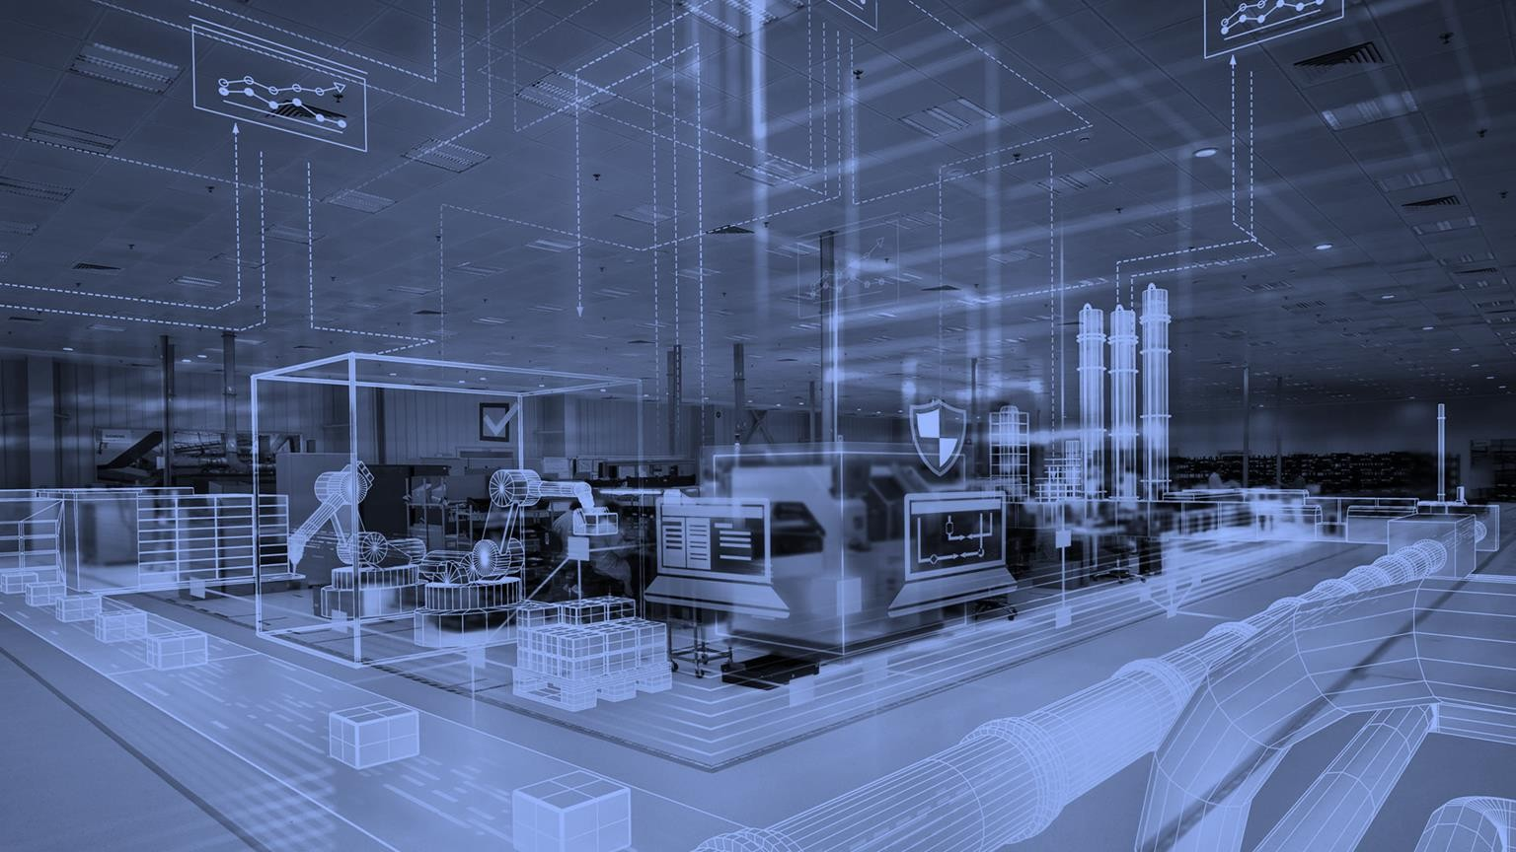
Industry Analysis

Slide 7



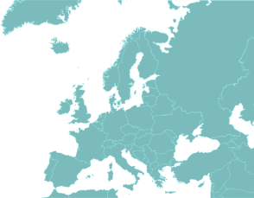

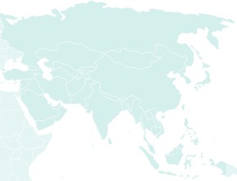

Global Industrials Overview
European industrials face several headwinds moving into 2023
Key challenges in 2022
Trends effecting critical end markets…
The war in Ukraine impacted overall economic conditions in the first quarter of calendar 2022. Energy prices – already soaring in the latter half of 2021 – sky- rocketed in the first half of calendar 2022
End market
Overall trends from 2022 to 2023
Jul 2022 Jul 2023
Aerospace - Commercial
Regulatory restrictions on several sectors and companies along with a recession. China’s GDP growth is expected to slow significantly in calendar 2022, to 3.0%, after it rebounded in calendar 2021 with 8.1%
Aerospace - Defense
Energy
Smart grid tech poised to have tailwinds in 2023
China’s zero-COVID strategy became even more strict with the emergence of highly infectious variants, resulting in more major lockdowns which burdened economic activity and global supply chains in the second half of calendar 2021
Power
Utilities
2023 outlook by global geography
Food Equipment
Europe
North America
Asia
Factory Automation
Building/Electrical/HVAC
Digital HVAC Solutions will be needed in 2024
Rental
Healthcare
European industrial demand could lose strength. Rising rates and sustained inflation mean consensus earnings may need to be cut by 10-15%. Defensive sectors including grid, energy and mining- equipment manufacturers could outperform
North American industrials' demand strength will lose momentum as economic and inflationary concerns cloud the outlook. Supply-chain eases, yet favorable pricing will temper with slowing demand. Sectors including energy and Aerospace could outperform
As the industry works off an order backlog and China eases Covid restrictions, demand for chipmaking equipment may fall while auto-sector investment has room for a delayed rebound
Automotive
Mining
Construction Equipment
Agriculture Equipment
Above Average
Average Below Average
Modestly Above Average Modestly Below Average
Source: (Bloomberg, 2023), (Capital Markets Day (Siemens, 2022))
7
Executive _{S}S_{u}u_{m}m_{m}m_{a}a_{ry}ry
Industry _{A}A_{n}n_{a}a_{ly}ly_{s}s_{is}is
Company O_{O}v_{v}e_{e}r_{r}v_{v}i_{i}e_{e}w_{w}
Financial O_{O}v_{v}e_{e}r_{r}v_{v}ie_{ie}w_{w}
Feasibility A_{A}n_{n}a_{a}ly_{ly}s_{s}is_{is}
Alternative S_{S}o_{o}lu_{lu}ti_{t}o_{io}n_{n}
Conclusion

Slide 8




Decarbonization TAM
Clean energy well positions many of Siemens’ core businesses to react to the addressable market
Decarbonization sits the center of a ~$5 Trillion TAM
$900-$1,000Bn $650-$950Bn $500-$900Bn $400-$500Bn
$400-$500Bn
$200-$500Bn
$90-$100Bn
$40-$100Bn
$10-$45Bn
$10-$25Bn
Decarbonization of power
Low carbon
mobility
Circular products & packaging
Low carbon agriculture and food supply chain
Low carbon proteins
High efficiency buildings
Hydrogen
Bioenergy
Industrial
decarbonization
CCUS
Carbon markets, offsets, financing
H₂ electrolyzers
H₂ blending materials
Bio-refineries
Green cement and CO₂ negative aggregates
Sorbents for carbon capture
Sub-themes
Renewable power generation
Electrification of vehicle power trains
Sorting and processing tech
Energy efficiency and building controls
Biofuel innovation
Offset project design, development
, and supply
Sustainable packaging
Sustainable timber
Offset project design, development, and supply
Microgrids and resiliency
Next-gen batteries
Building
electrification
Hydrogen mobility
Waste to energy/value
High efficiency iron & steel productions
Flexibility and energy storage
Sustainable fashion
Tech enhancements for crop yields
Marketplaces and exchanges
Charging infra and energy services
Green building materials
Project development
Marketplaces and exchanges
Decarbonization of industrial process heat
Grid and Customer energy analytics
Circular products and upcycling
Crop preservation/ waste reduction
On-site clean energy
Carbon credit brokers and retailers
Carbon credit brokers and retailers
Fleet decarbonization
Industrial energy
efficiency
Advanced Solar and PV technology
Reverse
logistics
Shipping and port decarbonization
Methane inhibitors
Supply chain services
Mobility
SI & DI
SI
Source: (McKinsey & Company (2), 2022)
8
Executive _{S}S_{u}u_{m}m_{m}m_{a}a_{ry}ry
Industry _{A}A_{n}n_{a}a_{ly}ly_{s}s_{is}is
Company O_{O}v_{v}e_{e}r_{r}v_{v}i_{i}e_{e}w_{w}
Financial O_{O}v_{v}e_{e}r_{r}v_{v}ie_{ie}w_{w}
Feasibility A_{A}n_{n}a_{a}ly_{ly}s_{s}is_{is}
Alternative S_{S}o_{o}lu_{lu}ti_{t}o_{io}n_{n}
Conclusion

Slide 9
Global Renewables Overview | Wind
A beneficiary of the push for cleaner energy with lingering concerns on profitability
Wind is a viable option for decarbonization…
Electricity sources by emissions
…which will increase its presence onshore and offshore
Installed wind power capacities forecast
Hydroelectric 4
Wind 10
Solar PV Natural Gas
Coal
3,000
2,500
2,708
30
In gigawatts (GW)
380
2,000
1001
0 100 200 300 400 500 600 700 800 900 1000 1100
1,500
1,000
500
0
1,086
1,328
1,008
401
299
616
gCO2/kWh
127
24
78
169
215
The push for decarbonization is continuing to play a pivotal role in both the acceptance and adaption of wind power systems
An estimated 1.7 billion tons of steel are needed to build enough wind turbines to reach net zero by 2050
2030
2050
2030
2050
Onshore
Offshore
APAC Americas EMEA
…with Asia being primed for offshore opportunities
Offshore wind installations in Asia by 2030
…but is still facing turbulence
Global wind turbine waste forecast
In metric tons
4,000
In megawatts (MW)
20,000
3,000
2,000
1,000
0
15,000
10,000
5,000
2029
2034 2039 2044
U.S. EU Rest of World
2049
0
2023
2024
2025
2026
2027
2028
2029
2030
Although wind turbine producers will benefit from the push for cleaner energy, 2022 was an unfavorable year due to supply chain issues, material inflation, and unfavorably priced contracts
China Japan South Korea Taiwan Vietnam India Other
Asia is expected to account for nearly 100 GW in offshore wind capacity by 2030 and account for over 60% of offshore wind capacity by 2050
Source: (Ferris, 2021), (GWEC, 2022, Statista), (Wood Mackenzie, 2022)
9
Executive _{S}S_{u}u_{m}m_{m}m_{a}a_{ry}ry
Industry _{A}A_{n}n_{a}a_{ly}ly_{s}s_{is}is
Company O_{O}v_{v}e_{e}r_{r}v_{v}i_{i}e_{e}w_{w}
Financial O_{O}v_{v}e_{e}r_{r}v_{v}ie_{ie}w_{w}
Feasibility A_{A}n_{n}a_{a}ly_{ly}s_{s}is_{is}
Alternative S_{S}o_{o}lu_{lu}ti_{t}o_{io}n_{n}
Conclusion

Slide 10






















Renewables Overview | Solar & EVs
Setting the stage for a transition to smarter and more efficient energy resources
Solar energy is a direct play into the grid…
…necessitating leaps in battery storage technology
Battery storage capacity outlook by geography
Federal policy supporting renewables
The current grid system is archaic and serves no direct benefit to the consumer beyond consumption
With developing renewable energy systems, consumers are now able to tie their residential systems into a Smart Grid through “Net- Metering”
The smart grid market size is growing steadily through 2026
1 3 2
Inflation Reduction Act (IRA)
GDIP
Chinese Subsidies
450
400
350
300
250
200
150
100
50
0
Allowing for millions of people to access
U.S.
Europe
China
In Mm gigawatts (GW)
383
wholesale markets
320
Low-carbon tech
Clean energy transition
Clean tech investment incentives
217
264
56
Federal tax
credits of
$369Bn
Credits under
negotiation
$275Bn of government subsidies
60
44
47
51
139
177
In $ Bn
40
37
40
105
Rapid access to funding
Response to the IRA and Chinese subsidies
42
71
Manufacturing of net-zero tech is dominated by China
20
Open trade for resilient supply chains
0
2022A 2023E 2024E 2025E 2026E 2027E 2028E 2029E 2030E
Asia Pacific Americas EMEA
More govt. support
2021A 2022A 2023E 2024E 2025E 2026E
Virtual Power Plants gives access to all players of the energy
Electric vehicle infrastructure is on the rise globally
grid system
Electricity grid
Electricity grid
1 million Tesla EVs
Were sold globally in 2021
25% of cars sold
in Germany in 2021 were EVs
Zero ICE cars to be sold in China by 2035
58% of all car sales
globally will be EVs by 2050
EV
Wind farms
EV
Wind farms
25
20
15
10
5
0
Global EV supply equipment market size
22
18
Consumers
VPP
Factories
VPP
Factories
In $ Bn
11
14
Consumers
9
During normal operation, a VPP can work to minimize electricity costs
If the grid is impacted, the VPP manages all connected energy resources to provide flexibility
5
6
7
2
2
3
4
External information
Solar panels
External information
Solar panels
2019A 2020A 2021A 2022A 2023E 2024E 2025E 2026E 2027E 2028E 2029E 2030E
Source: (NextMSC, 2020, Statista), (Business Wire, 2021, Statista), (Barclays, 2023), (Bloomberg NEF, 2023), (Wood Mackenzie (1), 2023)
10
Executive _{S}S_{u}u_{m}m_{m}m_{a}a_{ry}ry
Industry _{A}A_{n}n_{a}a_{ly}ly_{s}s_{is}is
Company O_{O}v_{v}e_{e}r_{r}v_{v}i_{i}e_{e}w_{w}
Financial O_{O}v_{v}e_{e}r_{r}v_{v}ie_{ie}w_{w}
Feasibility A_{A}n_{n}a_{a}ly_{ly}s_{s}is_{is}
Alternative S_{S}o_{o}lu_{lu}ti_{t}o_{io}n_{n}
Conclusion

Slide 11

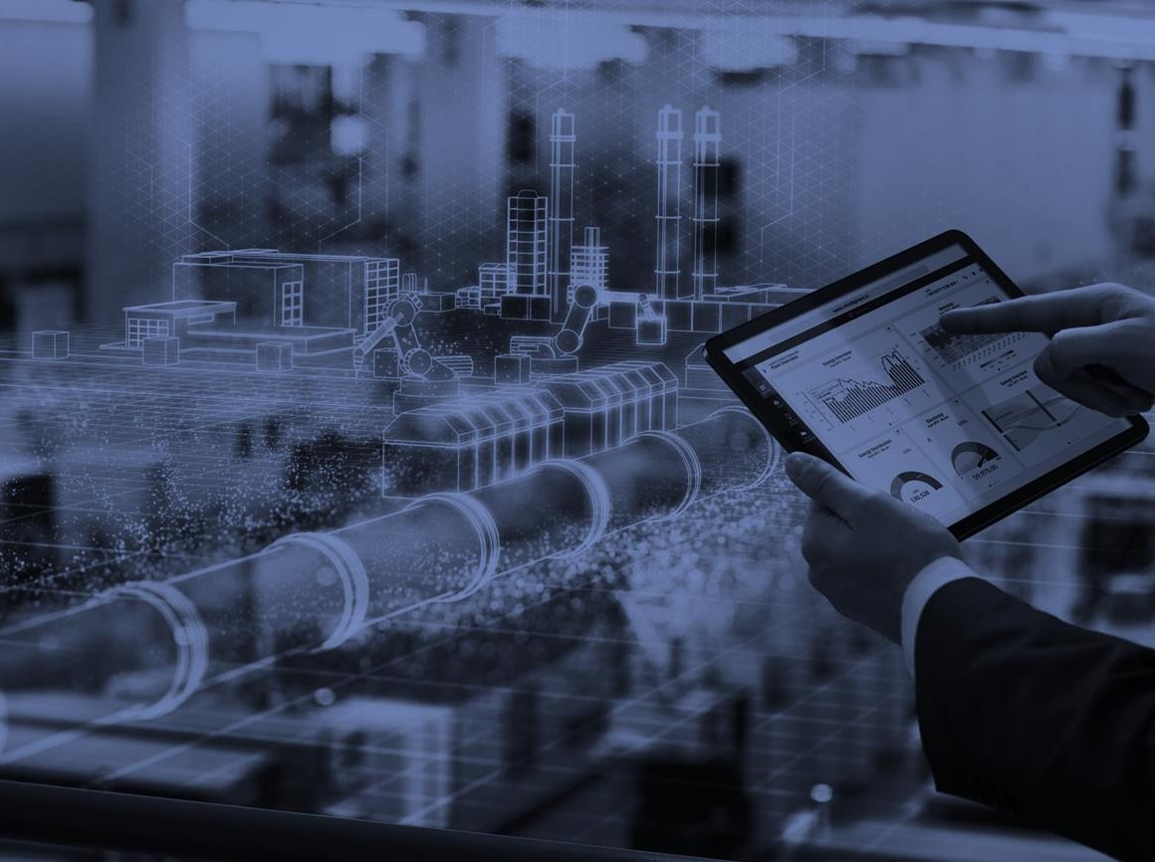



Company Overview
Overview
Overview
+
Strategic Fit

Slide 12



Company Overview
Overview

Slide 13














Siemens Overview
Siemens is a German engineering giant who invests heavily in technologies of the future
10,000-foot view of Siemens
Secular trends driving new opportunities…
…and Siemens is allocating resources into these areas
Siemens AG (SIE-DE) is an engineering and manufacturing company headquartered in Munich, Germany that focuses on areas of electrification, automation, and digitalization
Siemens is the largest industrial manufacturing company in Europe
The company’s revenues are segmented into four distinct areas: Siemens Healthineers, Digital Industries, Smart Infrastructure, Mobility + Other
Part of Siemens’ strategy revolves around divestitures of capitally intensive business models while strengthening their brand of renewables through M&A
Smart Infrastructure focuses on decarbonizing energy sources and seeks to capitalize on Europe's renovation wave with their suite of building technologies
“Today, Siemens AG focuses on future-oriented technology fields. It combines hardware, software and innovative services to create value.” – Jim Hagemann Snabe – Chairman of the Supervisory Board
Smart infrastructure investment in Building X and intelligent grids
Emphasis on sustainable, equitable transportation, and personalized healthcare
>6.0
R&D in $ Bn
0.2
1.9
Investing in decarbonization, energy, and resource efficiency
Renewed investment by governments worldwide in infrastructure
0.4
0.7
European energy and input crisis exposing inefficiency
2.6
Labor shortages driving demand for efficient automation and process systems
2022A
2023E
2022 2023E
DI SI
…that has seen steady revenue growth
$90,000
MO SHL T/Other
A coordinated portfolio of product and service segments…
Digital Industries
Automation technology services and operating system software related to manufacturing
Other
Other segments consist of Mobility, Portfolio Companies, and Siemens Financial Services
$75,000
$76,571
$62,215
$66,238
18.6%
$60,000
$60,786
20.5%
In $ Mm
25.2%
23.4%
24.1%
$45,000
24.1%
Smart Infrastructure
Connecting buildings’ energy systems - R&D enhances digital offerings related to renewable energy integration
Healthineers
Develops, manufactures, and sells a range of diagnostic and therapeutic products to healthcare providers
23.9%
25.1%
27.1%
$30,000
26.5%
26.2%
26.2%
30.2%
$15,000
28.9%
24.6%
25.3%
$0
2019
Siemens Healthineers
2020
Digital Indsutries
2021
Smart Infrastructure
2022
Other
Source: (Annual Report (Siemens, 2022)), (Earnings Release (Siemens, 2022))
Note: Expressed in USD with a conversion rate of 0.94 as of 2/20/23
Executive _{S}S_{u}u_{m}m_{m}m_{a}a_{ry}ry
Industry _{A}A_{n}n_{a}a_{ly}ly_{s}s_{is}is
Company O_{O}v_{v}e_{e}r_{r}v_{v}i_{i}e_{e}w_{w}
Financial O_{O}v_{v}e_{e}r_{r}v_{v}ie_{ie}w_{w}
Feasibility A_{A}n_{n}a_{a}ly_{ly}s_{s}is_{is}
Alternative S_{S}o_{o}lu_{lu}ti_{t}o_{io}n_{n}
Conclusion
13

Slide 14

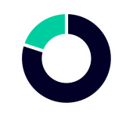
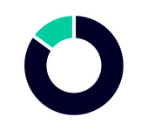
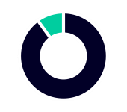

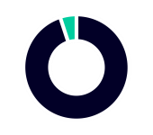






Siemens Overview | Digital Industries
Revolutionizing manufacturing processes through modern technological solutions
Segment overview
Three influential business trends
By fusing the physical and digital worlds and harnessing the power of both hardware and software, Digital Industries assists clients in fully realizing the potential of data for their business
By combining operations that formerly operated in independent streams of data, they enable the Industrial Internet of Tings (IoT) a network that spans the entire value chain, from shop floors to corporate headquarters and from sensors to cloud
The Digital Enterprise Portfolio is the centerpiece of its offerings which assist business’ in reducing development timelines and enhancing flexibility, productivity and environmental efficiency of their manufacturing processes
In today’s increasingly digitalized environment, producers of investment goods must modernize production capacity in order to effectively increase production flexibility and reduce process timelines
Current conditions encourages producers to complement their primary products with service options and vertical solutions, which consumers
desire to take advantage of investment goods in their entirety
Trends are shifting away from globalization towards reorganization to support local economic development, strengthen supply chains, and
better adapt solutions to needs on a regional level
Continued growth in vertical end markets
20%
Machine Building
15%
Pharma and Chemicals
10%
Digital Industries has significantly transformed business
Automotive
processes
10x faster innovation process
No. 1 for automation systems and industrial software
Food & Beverage
Electronics & Semiconductors
Aerospace &
Defense
10%
10%
5%
With increasing annual recurring revenue
24/7
activities to ensure industrial security
30% savings in service and maintenance costs
+14%
Digital Industries
$3.1
$3.2
$3.3
$3.5
$3.8
$3.7
In $ Bn
50% faster time to market with the digital twin
99.99%
quality through Digital technologies
Q4 FY21 Q1 FY22 Q2 FY22 Q3 FY22 Q4 FY22 Q1 FY23
Source: (Annual Report (Siemens, 2022), (Busch, R., Ag, S. and Thomas, R., 2023), (Siemens, 2023), (Bloomberg, 2023)
Note: Expressed in USD with a conversion rate of 0.94 as of 2/20/23
14
Executive _{S}S_{u}u_{m}m_{m}m_{a}a_{ry}ry
Industry _{A}A_{n}n_{a}a_{ly}ly_{s}s_{is}is
Company O_{O}v_{v}e_{e}r_{r}v_{v}i_{i}e_{e}w_{w}
Financial O_{O}v_{v}e_{e}r_{r}v_{v}ie_{ie}w_{w}
Feasibility A_{A}n_{n}a_{a}ly_{ly}s_{s}is_{is}
Alternative S_{S}o_{o}lu_{lu}ti_{t}o_{io}n_{n}
Conclusion

Slide 15










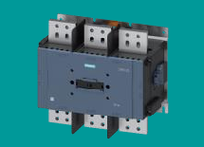
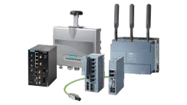
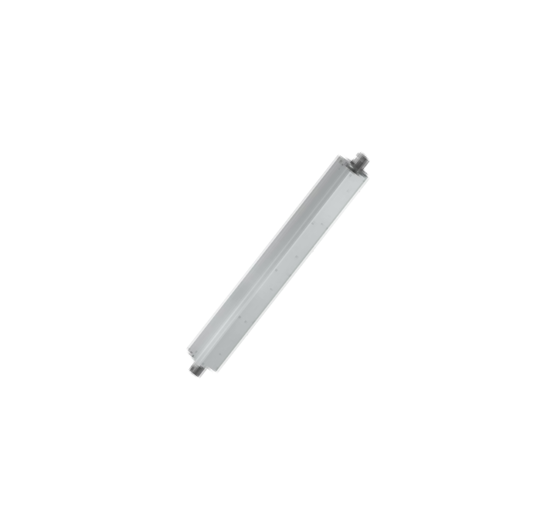
Siemens Overview | Smart Infrastructure
Diversified product line to support a transition from fossil to renewable energy sources and smarter more sustainable communities
Segment overview
Smart infrastructure product mix
Sustainable energy transition and sustainable communities represent a massive market
Siemens Smart Infrastructure Segment is focused on intelligently connected energy systems, buildings, and industry
The smart infrastructure segment offers a wide array of market specific solutions for industries such as airports, data centers, smart urban communities, transportation and logistics, and wind
The wind product offerings focus on power transmission and distribution systems, auxiliary monitoring, and industrial communication; all with the goal of optimizing wind power systems
By offering products which digitize global infrastructure, energy utility companies, airports, and municipalities can run efficiently, safely and reliably
These smart infrastructure products also mitigate risk in what are normally large investments, making sure they work perfectly and efficiently every time
Electrification:
27% of FY22
revenue
~$196Bn
Infrastructure market
~3%
CAGR
Buildings:
42% of FY22
revenue
Electrical Products:
31% of FY22
revenue
Building our future energy resources intelligently…
Investment In Smart Infrastructure on the rise
Smart Grid Investments By Sub-Vertical
SIRIUS 3RT
Reliable circuit breaker rated to produce technical data in the harshest of ambient conditions
Compliant with worldwide standards resulting in high TAM
16
Smart grid-related operations IT
"Pure" smart grid devices/systems
14
Smart-grid related administrative IT
Investment in $ Bn
12
2.5
SCALANCE & RUGGEDCOM
Offers real-time status and performance information in the most
remote of wind fields
Helps customers integrate wind turbines optimally into their networks
10
1.9
8
1.5
6.4
6
4
2
0
1.2
5.1
SIVACON 8PS
Delivers economical and secure supply of energy while lowering total cost of energy
Bears thermal load better than traditional cables
0.9
2.8
3.8
0.7
2.1
4.9
1.5
1.8
2.4
3
3.8
1.2
2014A 2016A
Feasibility A_{A}n_{n}a_{a}ly_{ly}s_{s}is_{is}
2018A 2020A 2022A 2024E
Note: Expressed in USD with a conversion rate of 0.94 as of 2/20/23
Source: (Capital Markets Day (Siemens, 2021)), (Bloomberg, 2023), (Smart Grid System Report, 2018, Statista)
Executive _{S}S_{u}u_{m}m_{m}m_{a}a_{ry}ry
Industry _{A}A_{n}n_{a}a_{ly}ly_{s}s_{is}is
Company O_{O}v_{v}e_{e}r_{r}v_{v}i_{i}e_{e}w_{w}
Financial O_{O}v_{v}e_{e}r_{r}v_{v}ie_{ie}w_{w}
Alternative S_{S}o_{o}lu_{lu}ti_{t}o_{io}n_{n}
Conclusion
15

Slide 16



















Siemens Overview | Mobility
Siemens is focused on modernizing their Mobility solutions by enhancing technological inputs
Re-imagining the oldest mass transit mode
Mobility operating metrics
Orders Revenue
Rolling Stock | Rail Infrastructure | Services | Turnkey
Manufactures trains for urban and regional transport including metro systems, trams, and light rail Short-distance, regional, and long- distance rolling stock | Rail automation and solutions Automatic train control systems Interlocking operations control and telematic systems Digital station solutions | Maintenance and digital services Consulting, planning, financing, construction Railigent X – open application suite leverages IoT and AI for rail asset management | Bundles consulting, planning, construction, service, and operation or complete mobility systems Complete rail solutions integrating the entire rail portfolio and beyond
$ Bn $ Bn
(42%)
4%
5.7
2.6
3.2
2.5
Q1 FY 22 Q1 FY23
Profit Margin
Q1 FY 22 Q1 FY23
Free Cash Flow
$ Mm
%
-130bps
9.30%
NA
111
Customer examples
Customer examples
Customer examples
Customer examples
8.00%
Q1 FY 22
Q1 FY23
Q1 FY 22 Q1 FY23
-
271
Offerings in mobility for the digital age
Core business is centered around ESG
Rail is the most environmentally friendly mode of transport
Train travel can make an important contribution to reach EU CO₂ emission targets by 2050
Expanding digital offerings to make smart transit systems
Mobility’s software business offers Intermodal solutions, including platforms for fleet management, route planning, ticketing and payment solutions, and data analytics
Growing digital transit Smart Infrastructure
In 2022 Siemens Acquired Sqills, a Dutch provider of cloud-based ticketing software
for public transportation operators
Sharpening focus on smart public rail transit
In 2022 Siemens also fully divested from Yunex, a road infrastructure solutions company
AA
Core ESG
efforts
+
Investment in sustainable technologies
Source: (Annual Report (Siemens, 2022)), (Capital Markets Day (Siemens, 2021))
Note: Expressed in USD with a conversion rate of 0.94 as of 2/20/23
Executive _{S}S_{u}u_{m}m_{m}m_{a}a_{ry}ry
Industry _{A}A_{n}n_{a}a_{ly}ly_{s}s_{is}is
Company O_{O}v_{v}e_{e}r_{r}v_{v}i_{i}e_{e}w_{w}
Financial O_{O}v_{v}e_{e}r_{r}v_{v}ie_{ie}w_{w}
Feasibility A_{A}n_{n}a_{a}ly_{ly}s_{s}is_{is}
Alternative S_{S}o_{o}lu_{lu}ti_{t}o_{io}n_{n}
Conclusion
16

Slide 17





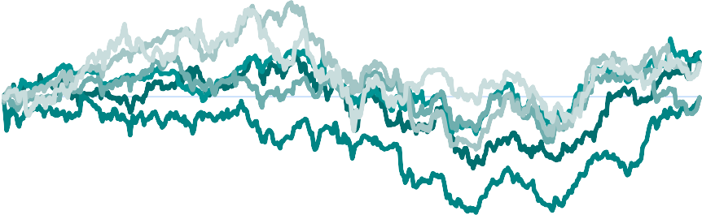
Siemens’ Market Positioning
Siemens’ size makes it the largest capital goods conglomerate in Europe
Comparable companies by market capitalization
Price/Earnings of companies comparable to Siemens
$120
$108.59
40.0x
36.5x
$100
₇₅th
$86.8B
35.0x
32.1x
31.2x
₇₅th 33.2x
$80
$79.57
30.0x
In $ Bn
$64.49
25.3x
Median: 28.3x
₂₅th 19.5x
$60
$43.42
$42.95
Median:
$30.9B
25.0x
20.7x
$40
$39.11
20.0x
15.8x
$20
25th
$19.5B
15.0x
$0
10.0x
2-Year global industrials comparative returns
Two-year return
One-year return
Premium company at a not-so-premium price
Although Siemens trades 4x above the sector median PE ratio, it is still a storied, diverse, and multinational corporation
Comparative returns
On a three-year basis, Siemens outperformed both the DAX index and the rest of its capital goods competitors (ex-Asia)
Siemens AG: Economies of scale
Siemens AG towers over its closest U.S. comp, General Electric, by roughly $30Bn
However, Siemens PE ratio is only one turn
above General Electrics PE
50.00%
40.00%
30.00%
20.00%
10.00%
0.00%
-10.00%
-20.00%
-30.00%
-40.00%
-50.00%
-60.00%
2021
12.13%
27.00%
(1.63%)
26.56%
% Return
11.03%
16.43%
36.40%
50.92%
2022
7.25%
(8.59%)
Siemens
General Electric
Illinois Tool Works
Emerson Electric Johnson Controls
Source: (Annual Report (Siemens, 2022)), (Bloomberg, 2023)
Hitachi
8.07%
8.21%
Executive _{S}S_{u}u_{m}m_{m}m_{a}a_{ry}ry
Industry _{A}A_{n}n_{a}a_{ly}ly_{s}s_{is}is
Company O_{O}v_{v}e_{e}r_{r}v_{v}i_{i}e_{e}w_{w}
Financial O_{O}v_{v}e_{e}r_{r}v_{v}ie_{ie}w_{w}
Feasibility A_{A}n_{n}a_{a}ly_{ly}s_{s}is_{is}
Alternative S_{S}o_{o}lu_{lu}ti_{t}o_{io}n_{n}
Conclusion
17

Slide 18

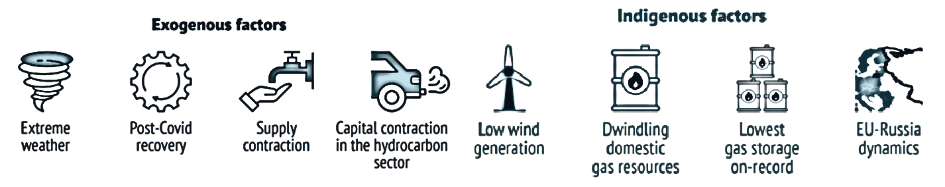
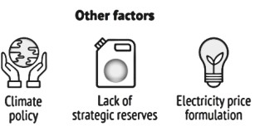

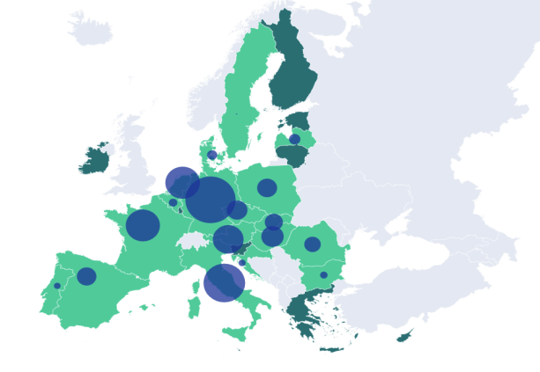







European Natural Gas Overview
Europe spared by mild winter, energy independence is still in question
European energy infrastructure exposed
Natural gas demand increases in low carbon scenario…
600
494
While Europe enjoyed a mild winter, gas prices have soared to all time highs, exposing how weak Europe's gas infrastructure is
This has shown evidence for the need to invest in clean energy solutions
500
303 Bn m³ imported from Russia.
Europe’s energy supply crunch has many facets
In Bn m³
400
340
300
303
200
154
191
100
0
Demand for Demand in other Total demand for producing fossil sectors fossil gas
hydrogen
Domestic European production
Shortfall to be covered by imports of fossil gas
Dutch TTF at all time highs…
…while demand for gas continues to rise…
…and the infrastructure isn’t
strong enough to fully support it
$ 300
LNG Cargos redirected to Europe
60000
21% CAGR from Jun ‘21 to Dec ‘22
$ 250
40% of total capacity comes from just four countries!
Germany and Austria account for 4% of Inventory
50000
$ 200
+1,200%
In Mm m³
40000
$ 150
Russia Ukraine tensions rock markets
30000
$ 100
20000
2022
2021
2020
$ 50
10000
$ 0
J-21 J-21 F-22 A-22 M-23
0
Storage available
No Storage (solidarity agreements made)
Storage capacity illustration
Jan
Feb
Mar
Apr May Jun Jul Aug Sep
Oct Nov Dec
Source: (GIE, 2022), (Global Witness, 2022, Statista), (McKinsey & Company, 2022), (Bloomberg, 2023), (EuroStat, 2023), (Factset, 2023), (Ember, 2023)
Executive _{S}S_{u}u_{m}m_{m}m_{a}a_{ry}ry
Industry _{A}A_{n}n_{a}a_{ly}ly_{s}s_{is}is
Company O_{O}v_{v}e_{e}r_{r}v_{v}i_{i}e_{e}w_{w}
Financial O_{O}v_{v}e_{e}r_{r}v_{v}ie_{ie}w_{w}
Feasibility A_{A}n_{n}a_{a}ly_{ly}s_{s}is_{is}
Alternative S_{S}o_{o}lu_{lu}ti_{t}o_{io}n_{n}
Conclusion
18

Slide 19




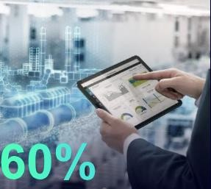
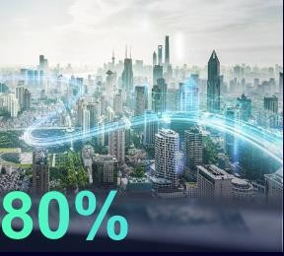
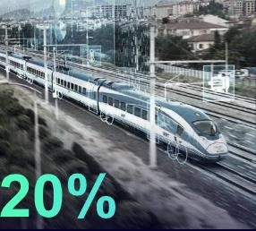














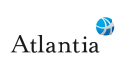




Siemens’ Strategic Direction
Emphasis on building a focused company, centered around automation technology
Both Siemens’ core and digital businesses
Addressable market growth with
attractive adjacent markets
Core technologies being leveraged across the
business
Digital Industries Smart Infrastructure Mobility
Cyber Security
reinforce one another
Siemens’ Digital Industries segments business model transitioned towards cloud-enabled SaaS. Transitioning to SaaS is assumed to drive predictable growth while remaining focused on core competencies
The company invested roughly $10Bn in software companies to enhance their technology stack
Digital business growth
Future Markets
Data Analytics & AI
Adjacent
Marke ts
~$130 Bn
Simulation & Digital Twin
Digital marketplaces
IoT and digital transformation services
Connectivity & Edge
Power Electronics
~10% CAGR
Additive Manufacturing
Addressable Markets
~$460 Bn
Connected (e)Mobility
$5.7Bn
…
14 Company Core technologies running across Siemens in total
2020A 2021A 2022A 2023E 2024E 2024E
The shift toward a tech focused business through investments and divestments…
…which plays directly into Siemens’ digital transformation Industry Infrastructure Mobility Healthcare
Siemens acquires buildings software firm Brightly for
$1.6Bn
Siemens takes a minority stake in US EV charging network company Electrify America
Vendigital is acquired by Siemens to boost its digital and strategic consulting service
2022
2020
2023
Siemens spun-off their Gas & Power segment to create the independent company, Siemens Energy
Clean exit from Valeo Siemens JV – Valeo bought the remaining stake in the JV
POC divests Siemens Parcel Logistics business for a post-tax gain of $0.8bn
of manufacturing tasks can be automated, improving productivity, quality, and safety
of lifecycle costs can arise from operations. Digital technologies can unlock savings potential of up to 20%
potential increase in transport capacity through digital signaling technology without building additional infrastructure
of stroke-related costs could be reduced by AI and digital-twin technologies
Atlantia agrees to acquire Siemens Yunex for $1.1Bn
Source: (Capital Markets Day (Siemens, 2021)), (Bloomberg, 2023)
Note: Expressed in USD with a conversion rate of 0.94 as of 2/20/23
19
Executive _{S}S_{u}u_{m}m_{m}m_{a}a_{ry}ry
Industry _{A}A_{n}n_{a}a_{ly}ly_{s}s_{is}is
Company O_{O}v_{v}e_{e}r_{r}v_{v}i_{i}e_{e}w_{w}
Financial O_{O}v_{v}e_{e}r_{r}v_{v}ie_{ie}w_{w}
Feasibility A_{A}n_{n}a_{a}ly_{ly}s_{s}is_{is}
Alternative S_{S}o_{o}lu_{lu}ti_{t}o_{io}n_{n}
Conclusion

Slide 20


Company Overview
Overview

Slide 21






Vestas Overview
An industry leader in renewable solutions with manufacturing, installment, and service in wind turbine operation across the globe
Company overview
Segment breakdown
Vestas (VWS-DK), is an industry leader in sustainability at the forefront of green energy transformation with an emphasis on the manufacturing, installment, and service of onshore and offshore wind turbines
Founded in 1945 by Peder Hansen, Vestas is currently headquartered in
Aarhus Denmark with offices spanning across 24 countries internationally
With 154 GW of wind turbines spread across 85 countries, Vestas has
Core competencies
Onshore Wind
With more than 40 years of experience, Vestas is the global leader in onshore wind with 164 GW of installed capacity and a suite of unique products
Offshore Wind
With 25+ years of experience, and re-entry into the market in 2020,Vestas’ turbines are designed to delivery exceptional performance in all conditions across the globe leading in both fixed-bottom and floating offshore wind
Track record of +8 GW and +1,500 turbines for 46 projects covering markets across Europe
Service
Provides onshore and offshore service solutions for both Vestas and non-Vestas turbines globally and services a portfolio of more than 140 GW, the largest fleet of wind turbines in the world, 55,00 turbines, across 74 countries by 10,000 dedicated technicians
installed more wind power than any other competitor
Vestas’ ten-year journey
2012
50 GW of installed capacity
2014
Launched a profitable growth strategy
2016
Acquired Availon Holding GmbH, an independent service provider
2018
100 GW of
installed capacity
2020
Introduced sustainability strategy
Acquired the offshore business
2022
Named the most sustainable company in the world
2013
Launched operating business model
2015
Acquired Upwind Solutions Inc
2017
Introduced the company’s vision to become global leader in sustainable energy solutions
2019
Launched new modular platform
2021
Implemented circularity roadmap
Launched development as a stand-alone business
Development – Non-revenue producing core competency
Maximizing wind resources through intensive and thorough development of new wind products with a 30+ GW project pipelines to accelerate energy transition (covers the phase of creating a power plant from initial planning through installation with key activities being securing land and permitting, designing sites and project offtake agreements, and ensuring grid connections
Breakout of revenue generating segments
18000
Enablers
Revenue in $ Mm
13000
2186
2643
3356
Service Adjacencies
Acquisitions and new revenue pipelines to accelerate service growth
Power-to-X
Indirect electrification to accelerate both onshore and offshore growth
Vestas Ventures
Accessing promising technologies to optimize wind turbine technology
1990
106
2486
993
8000
1776
9005
10932 | 13472 | 11453 | 11062
2019 | 2020 | 2021 | 2022
3000
-2000
2018
Power Solutions (Onshore) Power Solutions (Offshore)
Service
Source: (Annual Report (Vestas, 2022), (Bloomberg, 2023), (Statista, 2023)
Note: Expressed in USD with a conversion rate of 0.94 as of 2/20/23
Executive _{S}S_{u}u_{m}m_{m}m_{a}a_{ry}ry
Industry _{A}A_{n}n_{a}a_{ly}ly_{s}s_{is}is
Company O_{O}v_{v}e_{e}r_{r}v_{v}i_{i}e_{e}w_{w}
Financial O_{O}v_{v}e_{e}r_{r}v_{v}ie_{ie}w_{w}
Feasibility A_{A}n_{n}a_{a}ly_{ly}s_{s}is_{is}
Alternative S_{S}o_{o}lu_{lu}ti_{t}o_{io}n_{n}
Conclusion
21

Slide 22
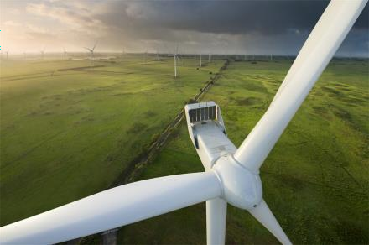

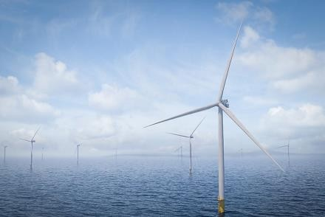

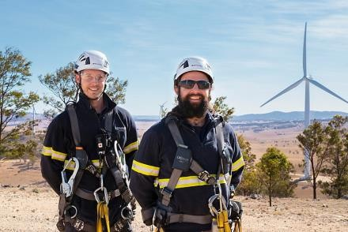

Vestas Product Overview
Vestas offer a wide array of onshore, offshore, and service solutions
Onshore offerings
EnVentus™ based variants are designed with global applicability in mind. As part of the suite of Vestas offerings, EnVentus™ turbines offer a wide range of standard hub heights and modes of operation that can be combined with an extensive list of technology options to create customized solutions to suit the needs of each unique project
Onshore Revenue
$ Bn
13.4
11.5
11.1
Enventus Platform
4 MW Platform
2 MW Platform
2020
2021
2022
Offshore offerings
Vestas offshore turbine platforms are designed with maximum reliability, ease of installation and servicing, and world-class performance in mind. Offshore turbines are available for both high and low wind geographies, including IEC T-class rating to protect against even the harshest typhoon conditions
Offshore Revenue
$ Bn
2.4
V236-15.0 MW
V174-9.5 MW
V164-10 MW
0.9
0.1
2020
2021
2022
Service offerings
Vestas now service more than 55,000 wind turbines and more than 10,000 dedicated service technicians across 74 countries work committedly to maintain and support the biggest wind turbine fleet in the world
Service Revenue
$ Bn _{3.4}
2.5
2.2
Maintenance
Parts & Repair
Fleet Optimization
2020
2021
2022
Source: (Annual Report (Vestas, 2022), (FactSet, 2023)
Note: Expressed in USD with a conversion rate of 0.94 as of 2/20/23
22
Executive _{S}S_{u}u_{m}m_{m}m_{a}a_{ry}ry
Industry _{A}A_{n}n_{a}a_{ly}ly_{s}s_{is}is
Company O_{O}v_{v}e_{e}r_{r}v_{v}i_{i}e_{e}w_{w}
Financial O_{O}v_{v}e_{e}r_{r}v_{v}ie_{ie}w_{w}
Feasibility A_{A}n_{n}a_{a}ly_{ly}s_{s}is_{is}
Alternative S_{S}o_{o}lu_{lu}ti_{t}o_{io}n_{n}
Conclusion

Slide 23
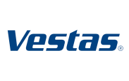

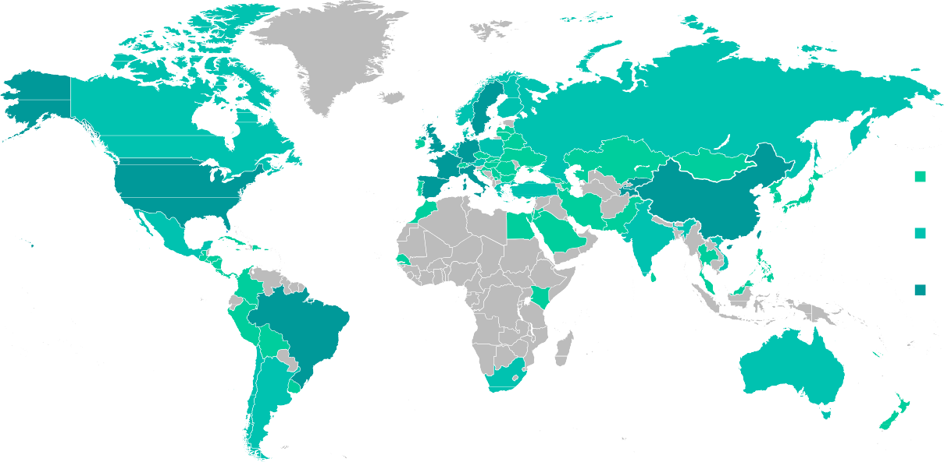




Vestas Market Presence
Expanding its leadership in efficient wind power generation systems
Summary of Vestas’ presence in the wind turbine market
Market share
Vestas’ revenue per geographical region
The global leader in wind energy service solutions with more than 144 GW under service, which is equivalent to almost 56,000 turbines
In 2022, Vestas delivered 3,300 turbines in 21 different countries
Remains the leader in onshore wind with 164 GW of installed capacity across the Americas, Asia Pacific, and EMEA
Expansion focus into offshore turbine production with strong expectations of USA and South Korea presence and a projected CAGR of 35-40%
Re-entered the offshore wind power segment in 2020 with expectations for
accelerated growth after 2024
Primary competitors include GE Renewable Energy, Siemens Gamesa Renewable Energy, and Goldwind
10.0
8.0
6.0
4.0
2.0
0.0
8.8
7.3
7.8
In $ Bn
5.4 5.3
5.3
4.8
5.1
18.97%
2.2
1.4
2.0
1.5
2019 2020
2021
2022
EMEA Americas Asia Pacific
Leading wind turbine producers by
gigawatts(GW)
 | 7.71
 |  | 8.30
 |  | 8.46
 |  | 8.64
The Vestas footprint in gigawatts (GW)
12.04
15.20
1-999
0.00 5.00 10.00 15.00
Capacity of delivered Vestas turbines
4,000
20.00
1000-4999
5000+
In megawatts (MW)
3,316
3,000
2,275
2,000
_{1,002} 1,185
1,528
1,000
480
578
790 818
957
399
0
Source: (Annual Report (Vestas, 2022)), (Bloomberg NEF, 2023), (Global Data, 2022), (Djunisic, 2022)
Others
Executive _{S}S_{u}u_{m}m_{m}m_{a}a_{ry}ry
Industry _{A}A_{n}n_{a}a_{ly}ly_{s}s_{is}is
Company O_{O}v_{v}e_{e}r_{r}v_{v}i_{i}e_{e}w_{w}
Financial O_{O}v_{v}e_{e}r_{r}v_{v}ie_{ie}w_{w}
Feasibility A_{A}n_{n}a_{a}ly_{ly}s_{s}is_{is}
Alternative S_{S}o_{o}lu_{lu}ti_{t}o_{io}n_{n}
Conclusion
23

Slide 24

Company Strategy to Further Expand into Offshore
With demand for onshore turbines facing headwinds, Vestas seeks to focus primarily on expansion into offshore in the coming years
Future emphasis on energy resiliency and transition to offshore wind
Building a leading global position in offshore through V236 turbine expansion
Global wind market capacity forecast in gigawatts (GW)
Americas
3.7 GW
140.00 128.80
Vestas is prominently positioned in Onshore as an industry leader and seeks to expand its offshore business with the goal to achieve revenue in Offshore of
+3Bn by 2025 with an EBIT margin on par with Onshore
Offshore remains the primary focus in 10 key markets which account for 80% of installment. It is being expanded through the development of floating solutions which allow deep sea penetration. Vestas plans to heighten partnership with offshore partners and secure orders for their V236-15.0 MW turbine
Asia Pacific
1.3 GW
120.00
100.00
80.00
60.00
40.00
20.00
0.00
119.40
102.40
105.70
2023
2024
2025
2026
EMEA
3.2 GW
Vestas’ expectations for growth…
Projected offshore wind installation growth by 2030 in gigawatts (GW)
Onshore
Offshore
Service
Development
Market Expectations
New Installments (GW)
CAGR:
Market Expectations
New Installments (GW)
CAGR:
35-40%
Global Expansion
Strong expansion in Europe and new markets such as the US and South Korea
Growth to accelerate after 2023
Market Expectations
New Installments (GW)
CAGR:
8-10%
Solid Growth
Promising growth from high base
Power price increases and electricity shortages to drive higher need for output
Vestas’ Expectations
New Installments (GW)
CAGR:
>10%
Foundation in place
Goal in Development to outgrow the total onshore market in firm order intake
Own developed projects to further leverage side deals
60
50
40
8-10%
Restarting Growth
Slight decline in activity expected in 2023
Increase in 2024 and 2025 attributed to the USA, Europe, and Africa
30
20
10
0
2023 2024 2025 2026 2027 2028 2029 2030
North America
Source: (Annual Report (Vestas, 2022), (GWEC, 2022, Statista), (Bloomberg, 2023)
Europe China Asia (excluding China)
Alternative S_{S}o_{o}lu_{lu}ti_{t}o_{io}n_{n}
Other
Executive _{S}S_{u}u_{m}m_{m}m_{a}a_{ry}ry
Industry _{A}A_{n}n_{a}a_{ly}ly_{s}s_{is}is
Company O_{O}v_{v}e_{e}r_{r}v_{v}i_{i}e_{e}w_{w}
Financial O_{O}v_{v}e_{e}r_{r}v_{v}ie_{ie}w_{w}
Feasibility A_{A}n_{n}a_{a}ly_{ly}s_{s}is_{is}
Conclusion
24

Slide 25

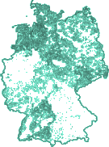


Key Challenges to Vestas’ Turbine Development Projects
Development of wind projects could face headwinds due to development barriers and the proliferation of other renewable energy sources
Scarcity of buildable land posing problems for
European Union electricity mix
Solar Wind Hydro Nuclear Bioenergy
developers looking to add onshore projects
50%
The loftiness country’s targets create extremely tight margins of error for developers of these projects
Other
Other Fossil
Gas
Coal
The decision for Vestas to focus on offshore seems more forced than a strategic move due to rising land costs, longer development times, and higher growth offshore
Potential land for
development
To meet German targets, 4% - 6% of land must be covered
7.3% 15.0% 10.1% 21.9%
Netherlands passes Spain as solar power leader…
14% 12%
6.0% 3.6%
19.9%
16.0%
Technical constraints
Regulatory constraints
Environmental constraints
0.2%
Top five countries in solar capacity additions in 2022
 | 7.9 GW added 7.5 GW added
 | 4.9 GW added
 | 4.0 GW added
 | 2.7 GW added
Slope of build site must meet specifications
Footprint of existing installations is large
Areas of the country are strictly protected such as national parks, wilderness, & natural monument
Key biodiversity areas
Loosely protected land pertaining to natural resources
9%
Land available less constraints
86%
88%
Energy Generated from
Other Sources Solar
Energy Generated from
Onshore wind projects take longer to build…
…and as solar installation costs decline…
6,000
Costs declining
…capacity in the EU could triple by ‘26
10
9
8
7
6
5
4
3
2
1
0
600
Projections
$ per kilowatt installed
_{5,000} 4,808
worldwide, creating access to solar
500
Number of years
4,104
400
4,000
300
200
100
0
3,124
3,000
2,742
2,478
2,000
1,887_{1,717}
1,483
1,267
1,046 ₉₁₆ ₈₅₇
1,000
United States Germany France Italy Spain
Solar Photovoltaics Onshore wind Median Duration
0
2010 2012 2014 2016 2018 2020
Actual
Forecast (medium)
Forecast (low)
Forecast (high)
Source: (Bloomberg NEF, 2022), (Christakou, 2022), (Council of the European Union, 2022), (EuroStat, 2022), (JPMorgan, 2022), (IRENA (2), 2022), (Ember, 2023)
25
Executive _{S}S_{u}u_{m}m_{m}m_{a}a_{ry}ry
Industry _{A}A_{n}n_{a}a_{ly}ly_{s}s_{is}is
Company O_{O}v_{v}e_{e}r_{r}v_{v}i_{i}e_{e}w_{w}
Financial O_{O}v_{v}e_{e}r_{r}v_{v}ie_{ie}w_{w}
Feasibility A_{A}n_{n}a_{a}ly_{ly}s_{s}is_{is}
Alternative S_{S}o_{o}lu_{lu}ti_{t}o_{io}n_{n}
Conclusion

Slide 26

Company Overview
+
Strategic Fit

Slide 27
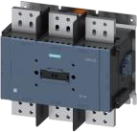
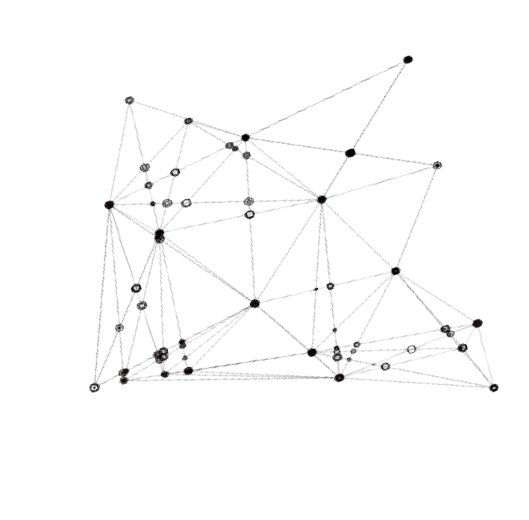
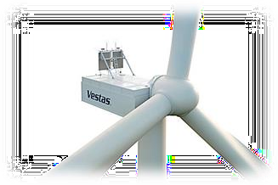

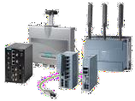

Strategic Fit Between Siemens and Vestas
The combined company providing a wide range of digitally connected products with access to financing
Smart Infrastructure
Offers products and services to support a sustainable transition from fossil to renewable energy sources as well as a transition to smarter, more sustainable buildings and communities
Siemens wind solutions portfolio pairs well with Vestas' infrastructure and offers industry-leading technology while elongating product lifecycles
By acquiring Vestas, Siemens would add a top player in the wind turbine industry, establishing a tight grip on the market
Vestas’ high growth GW installment would allow Siemens to continue expansion into untapped markets and gain recurrent revenue from Vestas’ prominent customer base
Siemens gains the world's largest wind supply chain
1
Product Contribution
Financial Services (SFS)
Provides financing solutions for Siemens’ customers in the form of debt and equity investments. Supports its customer base with leasing, lending, working capital and structured financing solutions, as well as equipment finance
Vestas can leverage the expertise of Siemens Financial Services through a wide array of debt, equity, and bespoke financing solutions to expand into the burgeoning North American market quicker
Vestas’ EBIT has historically faced challenges, but could be resolved by a capital infusion from Siemens in supply chain optimization, warranty provisions and labor/execution investments
North American offshore has a plethora of tailwinds
2
Greater Access to Capital
IoT Integration
Source: (Annual Report (Siemens, 2022))
Executive _{S}S_{u}u_{m}m_{m}m_{a}a_{ry}ry
Industry _{A}A_{n}n_{a}a_{ly}ly_{s}s_{is}is
Company O_{O}v_{v}e_{e}r_{r}v_{v}i_{i}e_{e}w_{w}
Financial O_{O}v_{v}e_{e}r_{r}v_{v}ie_{ie}w_{w}
Feasibility A_{A}n_{n}a_{a}ly_{ly}s_{s}is_{is}
Alternative S_{S}o_{o}lu_{lu}ti_{t}o_{io}n_{n}
Conclusion
27

Slide 28



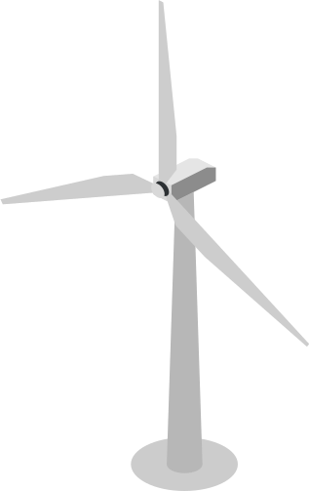


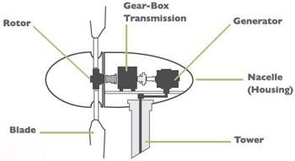


Vestas Strategic Fit | Product Contribution
Siemens wind solutions portfolio couples well with Vestas’ products
Siemens can support Vestas’ infrastructure through technological solutions
Vestas is a promising opportunity for Siemens to optimally employ their wind solutions in the global wind industry
Cumulative Installed Wind Power Capacity Worldwide
900
800
700
600
500
400
300
200
100
0
Siemen’s offers a comprehensive portfolio of advanced technological solutions applicable to Vestas’ infrastructure
The two companies' capabilities and products compliment each other nicely
Siemens can capitalize on Vestas’ growing installments to increase revenue and market share in their wind solutions
In GW
2001 2002 2003 2004 2005 2006 2007 2008 2009 2010 2011 2012 2013 2014 2015 2016 2017 2018 2019 2020 2021
Acquiring the world’s largest wind supply chain
Siemens provides Vestas the technology to elongate lifecycles
Raw Data Export
Turbine Main Control
CM
S7-1200 CPU
SM1281
SM1281
SM1281
Operational Data
Router
Siemens
Performance improvements through deep insights, analysis and visualization
Placement/type sensors
Continuous monitoring
Data analysis
Remote diagnostics
Maintenance recommendation
Expert Analysis
Siemens
Pitch Control: Optimizing power of turbine outputs and protect against excessively high wind speeds
Yaw: Motors turn the entire nacelle to direction optimal for wind generation
SIROUS switchgears: Controls voltages which in turn saves space and money in the control cabinet and increases energy efficiency
Source: (GWEC, 2022, Statista), (Annual Report (Siemens, 2022), (Annual Report (Vestas, 2022), (Siemens, 2023), (Bloomberg, 2023)
28
Executive _{S}S_{u}u_{m}m_{m}m_{a}a_{ry}ry
Industry _{A}A_{n}n_{a}a_{ly}ly_{s}s_{is}is
Company O_{O}v_{v}e_{e}r_{r}v_{v}i_{i}e_{e}w_{w}
Financial O_{O}v_{v}e_{e}r_{r}v_{v}ie_{ie}w_{w}
Feasibility A_{A}n_{n}a_{a}ly_{ly}s_{s}is_{is}
Alternative S_{S}o_{o}lu_{lu}ti_{t}o_{io}n_{n}
Conclusion

Slide 29






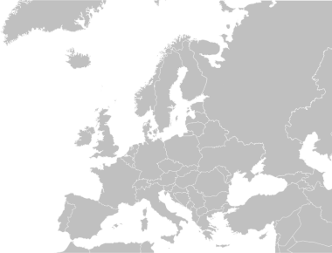

Vestas Strategic Fit | Greater Access to Growth Capital
Siemens Finance Services gives Vestas the capital they need to grow their offshore expansion
Dedicated financing arm… …capital infusion in offshore…
SFS invests in:
Supply chain optimization
Warranty provisions
Vestas offshore expansion needs capital
Vestas has hosted numerous offshore wind summits involving the EU commission and several Baltic countries
Gained further momentum within Offshore with 5 GW of preferred supplier agreements for the V236-
15.0 MW
By Joining forces with SFS, Siemens could grow their wind footprint further through the following investments
2,196
Labor/execution
877
11,998
12,316
In $ Bn
9,659
10,651
7.2
3.1
1.4
…using Siemens Financial Services capabilities…
2019
2020
2021
2022
Debt
Equity
Bespoke
Onshore Revenue
Offshore revenue
EBIT Margin
-13.1
… to capture North American growth opportunities
+3 GW
Siemens offers debt financing for Capex, expansion, and acquisition
Siemens Finance Services committed $100mm of multilender ABL revolver to AK steel to increase flexibility and earnings
Siemens can also invest in equity stakes of up-and- coming sustainability ventures
Siemens invested an equity stake into an Ohio based vertical farming company which needed capital for growth and implementation of proven technology
Senior secured debt
Revolvers
Term loans A & B
Delayed draw facilities
Equipment finance and leasing
Asset-based lending
Specialty
finance (structured products and equity co- investments)
America’s
10 GW
EMEA 7 GW
Vestas global development pipeline
President Biden considering auction of Gulf of Mexico for offshore wind production
Through the IRA, floating offshore wind costs may be cut 70% by 2035
Two-thirds of U.S. offshore wind resources are in deepwater areas, where conventional turbines aren’t an option
Source: (Capital Markets Day (Vestas, 2022)), (Bloomberg, 2023)
29
Executive _{S}S_{u}u_{m}m_{m}m_{a}a_{ry}ry
Industry _{A}A_{n}n_{a}a_{ly}ly_{s}s_{is}is
Company O_{O}v_{v}e_{e}r_{r}v_{v}i_{i}e_{e}w_{w}
Financial O_{O}v_{v}e_{e}r_{r}v_{v}ie_{ie}w_{w}
Feasibility A_{A}n_{n}a_{a}ly_{ly}s_{s}is_{is}
Alternative S_{S}o_{o}lu_{lu}ti_{t}o_{io}n_{n}
Conclusion

Slide 30
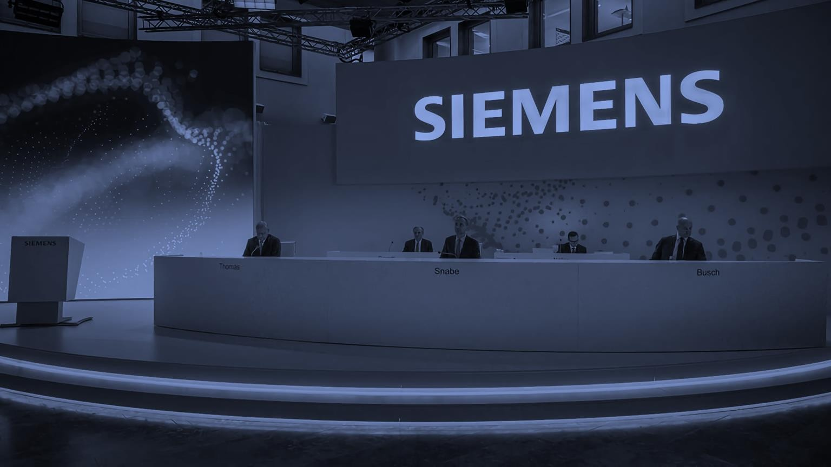
Financial Overview | Comps

Slide 31


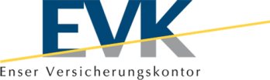










Vestas Potential Peer Groups
The peer group for Vestas encompasses turbine manufacturers, wind field services and management, and wind developers
Turbine manufacturers
Wind field services
Logic: Vestas’ largest revenue segment is turbine manufacturing and is the largest manufacturer in the space
Logic: Vestas’ offers limited servicing capabilities to the wind industry, demand for services will only grow with the proliferation of wind power
Wind developers
Logic: Vestas has only developed wind fields in the United States, the above companies offer opportunity to expand their development globally
Source: (Bloomberg, 2023)
Executive _{S}S_{u}u_{m}m_{m}m_{a}a_{ry}ry
Industry _{A}A_{n}n_{a}a_{ly}ly_{s}s_{is}is
Company O_{O}v_{v}e_{e}r_{r}v_{v}i_{i}e_{e}w_{w}
Financial O_{O}v_{v}e_{e}r_{r}v_{v}ie_{ie}w_{w}
Feasibility A_{A}n_{n}a_{a}ly_{ly}s_{s}is_{is}
Alternative S_{S}o_{o}lu_{lu}ti_{t}o_{io}n_{n}
Conclusion
31

Slide 32
Comparable Company Selection
Selection of Vestas’ peer group was determined via examining comparable companies’ relevance to Vestas’ brand as well as revenue and cost drivers
Market size Market size CAGR Brand relevance Revenue drivers Cost drivers Decision
₋ 6.3% _{NM} (‘22-’30) | Decarbonization ▪ Labor availability investments ▪ Supply chain Alternative energy drags demand ▪ Cheap natural gas Offshore expansion ▪ Unfavorable Development legislation | NM
Manufacturing ^{$136.2Bn 9.4%} (‘23e) (‘22-’30) | Decarbonization ▪ Labor availability investments ▪ Supply chain Alternative energy drags demand ▪ Cheap natural gas Offshore expansion ▪ Unfavorable Development legislation
_{Development} $62.1Bn 9.3% (‘23e) (‘20-’27) | Decarbonization ▪ Labor availability investments ▪ Supply chain Alternative energy drags demand ▪ Cheap natural gas Offshore expansion ▪ Unfavorable Development legislation
_{Services} $36.2Bn 8.4% (‘23e) (‘22-’30) | Decarbonization ▪ Labor availability investments ▪ Supply chain Alternative energy drags demand ▪ Cheap natural gas Offshore expansion ▪ Unfavorable Development legislation
Source: (Annual Report (Vestas, 2022)), (Bloomberg, 2023), (Deloitte, 2022)
32
Executive _{S}S_{u}u_{m}m_{m}m_{a}a_{ry}ry
Industry _{A}A_{n}n_{a}a_{ly}ly_{s}s_{is}is
Company O_{O}v_{v}e_{e}r_{r}v_{v}i_{i}e_{e}w_{w}
Financial O_{O}v_{v}e_{e}r_{r}v_{v}ie_{ie}w_{w}
Feasibility A_{A}n_{n}a_{a}ly_{ly}s_{s}is_{is}
Alternative S_{S}o_{o}lu_{lu}ti_{t}o_{io}n_{n}
Conclusion

Slide 33











Peer Group Statistical Analysis
Historical enterprise value, market cap, sales, and projections for EBITDA, EBIT, and net income margin for the upcoming FY
*Note: Values as of 3/7/23
Enterprise value*
Market capitalization*
Sales FY‘20 – FY’22*
EBITDA less CapEx
EBITDA margin 2023E*
EBIT margin 2023E*
$29,998 MM
$30,027 MM
16,582
($466)
7.1%
1.1%
15,765
15,411
Median: 10%
Median: 4.8%
8,145
7,841
6,619
LTM
$13,087 MM
$6,422 MM
($507)
15.0%
9.0%
875
414
444
$1,656 MM
$1,289 MM
$102 mm
12.9%
8.9%
5,310
6,439
5,811
LTM
$3,059 MM
$3,250 MM
($414)
(4.0%)
(7.0%)
3,258
4,211
4,940
LTM
$8,512 MM
$8,033 MM
NM
15.9%
14.6%
107
96
84
$593 MM
$376 MM
($64)
(77.6%)
(92.6%)
Source: (Bloomberg, 2023), (FactSet, 2023)
33
Executive _{S}S_{u}u_{m}m_{m}m_{a}a_{ry}ry
Industry _{A}A_{n}n_{a}a_{ly}ly_{s}s_{is}is
Company O_{O}v_{v}e_{e}r_{r}v_{v}i_{i}e_{e}w_{w}
Financial O_{O}v_{v}e_{e}r_{r}v_{v}ie_{ie}w_{w}
Feasibility A_{A}n_{n}a_{a}ly_{ly}s_{s}is_{is}
Alternative S_{S}o_{o}lu_{lu}ti_{t}o_{io}n_{n}
Conclusion

Slide 34
Peer Group Trading Multiples
For leading providers of wind solutions
2023E EV /
Sales
2023E EV / EBITDA
EV / Installed MW
1.86
26.02
187.29
Median: 1.94
Median:13.07
Median: 165.54
2.02
13.49
143.79
1.88
14.70
83.74
0.53
NM
429.93
2.00
12.64
Undisclosed
6.82
NM
Undisclosed
Source: (Bloomberg, 2023), (FactSet, 2023)
34
Executive _{S}S_{u}u_{m}m_{m}m_{a}a_{ry}ry
Industry _{A}A_{n}n_{a}a_{ly}ly_{s}s_{is}is
Company O_{O}v_{v}e_{e}r_{r}v_{v}i_{i}e_{e}w_{w}
Financial O_{O}v_{v}e_{e}r_{r}v_{v}ie_{ie}w_{w}
Feasibility A_{A}n_{n}a_{a}ly_{ly}s_{s}is_{is}
Alternative S_{S}o_{o}lu_{lu}ti_{t}o_{io}n_{n}
Conclusion

Slide 35

Enterprise Value vs. Megawatts Installed
Examining corporation size compared to installment across Vestas’ peer group
EV Compared to Megawatts Installed
35,000
High correlation between company’s enterprise value and megawatts installed
30,000
As the enterprise value becomes larger, the number of megawatts installed also grows
The relationship between the enterprise value and megawatts installed can be explained by 87% of the time
This correlation confidently explains that as the company grows in market size, their installation capacity will also increase
y = 0.1617x + 2007.8 R² = 0.8795
25,000
In $ Mm
20,000
15,000
10,000
Projected megawatts
Megawatts installed for Inox Wind and MingYang were not disclosed
Estimated MW based on the average EV/Installations ratio of 0.28x yield values 130MW for Inox and 1,863MW for MingYang
5,000
0
0 20000
40000
60000
80000
100000
120000
140000
160000
180000
Source: (Bloomberg, 2023), (FactSet, 2023)
35
Executive _{S}S_{u}u_{m}m_{m}m_{a}a_{ry}ry
Industry _{A}A_{n}n_{a}a_{ly}ly_{s}s_{is}is
Company O_{O}v_{v}e_{e}r_{r}v_{v}i_{i}e_{e}w_{w}
Financial O_{O}v_{v}e_{e}r_{r}v_{v}ie_{ie}w_{w}
Feasibility A_{A}n_{n}a_{a}ly_{ly}s_{s}is_{is}
Alternative S_{S}o_{o}lu_{lu}ti_{t}o_{io}n_{n}
Conclusion

Slide 36
EV/EBITDA 2023e vs 2023 EBITDA Margin
EV/EBITDA Multiples vs. EBITDA Margin for Vestas’ peer group
EV/EBITDA 2023E vs 2023E EBITDA Margin
Vestas
Vestas’ EV/EBITDA average was pulled down by its -53.3x multiple in FY22 driven by an EBITDA of $-75.8 million, due to increased SG&A expenses
30x
Suzlon
Suzlon’s COGS is highly correlated to their revenues and their EBITDA is generally very consistent with top line growth
In FY20 when revenues declined by almost 72%, the company experienced a negative EBITDA
25x
20x
Nordex
In the past 5 years, Nordex has had positive EV/EBITDA multiples with the acceptation of FY20 when EBITDA hit $-251.6 million; EBITDA expected to be volatile in the future
Not Meaningful
Nordex and Inox wind both have negative EBITDA multiples making their data not meaningful to the peer group
15x
Goldwind
Goldwind has the second highest margins among its peers and has proven power in generating strong EBITDA
10x
Inox Wind
Inox has suffered from its operating expenses causing negative
margins
In FY22, the company saw $84 million in revenues, offset by its
$136 million in OpEx resulting in an operating margin of -62.3% and a profit margin of -68.2%
5x
MingYang Smart Energy
Ming Yang maintains the strongest margins comparative to
peers with a robust 15.8% EBITDA margin, high for its capitalintensive industry average
x
Source: (Bloomberg, 2023), (FactSet, 2023)
5.00%
10.00%
15.00%
20.00%
Executive _{S}S_{u}u_{m}m_{m}m_{a}a_{ry}ry
Industry _{A}A_{n}n_{a}a_{ly}ly_{s}s_{is}is
Company O_{O}v_{v}e_{e}r_{r}v_{v}i_{i}e_{e}w_{w}
Financial O_{O}v_{v}e_{e}r_{r}v_{v}ie_{ie}w_{w}
Feasibility A_{A}n_{n}a_{a}ly_{ly}s_{s}is_{is}
Alternative S_{S}o_{o}lu_{lu}ti_{t}o_{io}n_{n}
Conclusion
36

Slide 37








Precedent Renewables Transaction Analysis
Renewables M&A activity has been slowly trending upward, fetching larger and larger multiples
Past Renewables Transaction TV/EBITDA
19.00x
Acquires
17.00x
16.61x
06/11/2018
10/20/2021
Acquires
15.00x
15.61x
Acquires
13.00x
Mean:
12.59x
11.50x
11.00x
05/21/2019
Rising Multiples & Institutional Support
Acquires
10/22/2022
Acquires
10.93x
Since mid-2016 TV/EBITDA multiples for renewable energy transactions have steadily been increasing
These rising premiums denote a higher demand for alternative energy coming from legacy industrial conglomerates
In addition, financial buyers from large institutions such as J.P. Morgan and Brookfield Infrastructure partners have joined the renewable energy industry
9.00x
10/11/2016
8.30x
7.00x
5.00x
5/10/2016
9/22/2017
2/4/2019
6/18/2020 10/31/2021
3/15/2023
Source: (Bloomberg, 2023)
Executive _{S}S_{u}u_{m}m_{m}m_{a}a_{ry}ry
Industry _{A}A_{n}n_{a}a_{ly}ly_{s}s_{is}is
Company O_{O}v_{v}e_{e}r_{r}v_{v}i_{i}e_{e}w_{w}
Financial O_{O}v_{v}e_{e}r_{r}v_{v}ie_{ie}w_{w}
Feasibility A_{A}n_{n}a_{a}ly_{ly}s_{s}is_{is}
Alternative S_{S}o_{o}lu_{lu}ti_{t}o_{io}n_{n}
Conclusion
37

Slide 38
Financial Overview | Discounted Cash Flow

Slide 39
Vestas Revenue Build
Business segment and total revenue breakdown through 2028
Power Solutions Revenue Breakdown by Product Offering
Service Solutions Revenue Breakdown
6,000
25,000
5,000
20,000
4,554
4,896
Revenue in $ Mm
5,169
6,227
Revenue in $ Mn
4,000
4,035
4,236
15,000
106
3,393
4,410
3,513
3,754
2,487
993
1,936
2,667
3,000
3,356
10,000
2,000
2,643
13,472
13,573
13,965
14,712
14,529
2,186
5,000
11,452
11,062
10,972
12,151
1,000
0
2020A
2021A 2022A 2023E 2024E 2025E 2026E 2027E 2028E
Onshore wind turbines Offshore wind turbines
0
2020A 2021A 2022A 2023E 2024E 2025E 2026E 2027E 2028E
Total Revenue Breakdown Derived From Each Segment
Total Revenue Breakdown
Over the course of the projected years (through FY28), revenue is expected to grow across all segments at a relatively consistent growth rate
As Vestas makes the transition to focus into offshore solutions, Onshore revenue generation levels out into 2028 and revenue growth is attributed to the company’s offshore products
Over the course of the 9-year period, onshore and offshore revenues are expected to grow at a CAGR of and .84% and 57.17% respectively, for a total CAGR of 4.8% while service is expected to grow at a CAGR of 9.4%
30,000
25,000
4,896
Revenue in $ Mm
20,000
4,236
4,554
3,754
4,035
15,000
2,186
2,643
3,356
3,513
10,000
16,967
18,375
19,882
20,756
5,000
13,579
13,939
12,054
12,908
14,818
0
2020A 2021A 2022A 2023E 2024E 2025E 2026E 2027E 2028E
Power solutions
Service
Source: (Bloomberg, 2023)
Executive _{S}S_{u}u_{m}m_{m}m_{a}a_{ry}ry
Note: Expressed in USD with a conversion rate of 0.94 as of 2/20/23
Industry _{A}A_{n}n_{a}a_{ly}ly_{s}s_{is}is
Company O_{O}v_{v}e_{e}r_{r}v_{v}i_{i}e_{e}w_{w}
Financial O_{O}v_{v}e_{e}r_{r}v_{v}ie_{ie}w_{w}
Feasibility A_{A}n_{n}a_{a}ly_{ly}s_{s}is_{is}
Alternative S_{S}o_{o}lu_{lu}ti_{t}o_{io}n_{n}
Conclusion
39

Slide 40








Vestas Discounted Cash Flow (1/2)
Vestas’ valuation and FCF projections
Fiscal Year Fiscal Year End Date |  | 2021A 12/30/21 | 2022A 12/30/22 | 2023E 12/31/23 |  |  |  | 2024E 12/30/24 |  | 2025E 12/30/25 | 2026E 12/30/26 | 2027E 12/31/27 | 2028E 12/30/28
Revenue |  | 15,765 | 16,582 | 16,421 |  |  |  | 18,572 |  | 21,002 | 22,611 | 24,436 | 25,652
% growth |  |  |  | (1.0%) |  |  |  | 13.1% |  | 13.1% | 7.7% | 8.1% | 5.0%
Adj. EBITDA |  | 1,514 | (61) | 1,714 |  |  |  | 2,464 |  | 3,404 | 3,401 | 3,631 | 3,736
% margin |  |  |  | 10.4% |  |  |  | 13.3% |  | 16.2% | 15.0% | 14.9% | 14.6%
Depreciation and amortization |  |  |  | (928) |  |  |  | (982) |  | (1,024) | (1,079) | (1,122) | (1,075)
Stock-based compensation |  |  |  | 1 |  | (8) |  | (7) |  | (3) | (2) | (2) | (3)
EBIT |  | 307 | (1,698) | 778 |  |  |  | 1,475 |  | 2,376 | 2,320 | 2,507 | 2,658
Tax Rate |  | 36.2% | 7.3% | 23.7% |  |  |  | 24.2% |  | 24.0% | 25.0% | 25.0% | 25.0%
EBIAT (NOPAT) |  | 196 | (1,574) | 594 |  |  |  | 1,118 |  | 1,806 | 1,740 | 1,880 | 1,993
Depreciation and amortization |  |  |  | 928 |  |  |  | 982 |  | 1,024 | 1,079 | 1,122 | 1,075
Working capital items: |  |  |  | 2 | 253 |  |  | 247 |  | 442 | 541 | 576 | 632
Unlevered CFO Capital Expenditures Unlevered FCF |  |  |  | 1,775 (591) 1,184 |  |  |  | 2,347 (669) 1,679 |  | 3,273 (756) 2,517 | 3,360 (814) 2,546 | 3,579 (880) 2,699 | 3,700 (923) 2,776
% growth |  |  |  |  |  |  | 3 |  | 41.8% | 49.9% | 1.2% | 6.0% | 2.9%
Discount factor Assume cash flows are generated at: |  |  |  | 181% |  |  |  | 281% |  | 381% | 481% | 581% | 681%
Midperiod adjustment factor |  |  |  | 1.8 |  |  |  | 1.0 |  | 1.0 | 1.0 | 1.0 | 1.0
Present value of Unlevered FCF |  |  |  | 1,076 |  |  |  | 1,314 |  | 1,771 | 1,612 | 1,536 | 1,421
4
Additional Commentary
1
Stock-based compensation treated as an expense for DCF valuation
Assumed non-cash add backs affect intrinsic valuation
3
Unlevered free cash flow growth in the first two years of the projection period is expected to grow at a high clip
The growth is due to increased development in offshore wind projects
Midperiod adjustment factor used to calculate present value of FCF
Assumed cash flows collected in the middle of the period as opposed to the end
Note: Expressed in USD with a conversion rate of 0.94 as of 2/20/23
2
Current liabilities of Vestas are much larger than current assets
Led by a large amount of contract liabilities and deferred revenue from developing wind equipment
4
Source: (Bloomberg, 2023)
Executive _{S}S_{u}u_{m}m_{m}m_{a}a_{ry}ry
Industry _{A}A_{n}n_{a}a_{ly}ly_{s}s_{is}is
Company O_{O}v_{v}e_{e}r_{r}v_{v}i_{i}e_{e}w_{w}
Financial O_{O}v_{v}e_{e}r_{r}v_{v}ie_{ie}w_{w}
Feasibility A_{A}n_{n}a_{a}ly_{ly}s_{s}is_{is}
Alternative S_{S}o_{o}lu_{lu}ti_{t}o_{io}n_{n}
Conclusion
40

Slide 41
Vestas Discounted Cash Flow (2/2)
Calculation of the weighted average cost of capital (WACC)
Cost of Capital Assumptions
Selected comparable companies' average cost of capital
Pre-tax cost of debt Tax rate
4.1%
25.0%
14.00%
Risk free rate | 2.9%
Beta | 1.2
Market risk premium | 7.1%
Cost of Debt
Pre-tax cost of debt | 4.1%
Tax rate | 25.0%
After-tax cost of debt | 3.1%
Cost of Equity
Risk free rate | 2.9%
Beta | 1.2
Market risk premium | 7.1%
Cost of Equity | 11.2%
Cost of Capital (WACC)
Capital weights
 | Amount % of total
Market value of equity | 29,489.6 | 100.0%
Market value of net debt | (211.7) | 0.0%
Cost of capital (WACC) |  | 11.2%
Total Market Ex.
12.00%
11.20%
11.76%
11.70%
Financials
10.01%
10.30%
10.00%
8.93%
8.60%
8.00%
6.00%
4.00%
2.00%
0.00%
Siemens cost of capital is higher than the subsector averages of the many sectors in which they operate in
This higher cost of capital represents the complex nature of Siemens business
By having several capitally intensive operating segments Siemens would benefit by moving away from heavier industries such as wind turbine manufacturing
Note: Expressed in USD with a conversion rate of 0.94 as of 2/20/23
Source: (Bloomberg, 2023)
Executive _{S}S_{u}u_{m}m_{m}m_{a}a_{ry}ry
Industry _{A}A_{n}n_{a}a_{ly}ly_{s}s_{is}is
Company O_{O}v_{v}e_{e}r_{r}v_{v}i_{i}e_{e}w_{w}
Financial O_{O}v_{v}e_{e}r_{r}v_{v}ie_{ie}w_{w}
Feasibility A_{A}n_{n}a_{a}ly_{ly}s_{s}is_{is}
Alternative S_{S}o_{o}lu_{lu}ti_{t}o_{io}n_{n}
Conclusion
41

Slide 42
Vestas DCF Sensitivity Analysis
Exit multiple and perpetuity growth rate with assumptions
Exit EBITDA Multiple Approach
Terminal year EBITDA | 3,463
Terminal value EBITDA multiple | 10.000x
Terminal value | 34,626
Present value of terminal value | 16,806
Present value of stage 1 cash flows | 8,730
Enterprise value | 25,535
Implied TV perpetual growth rate | 2.537%
Perpetuity Approach
FCF in Last Forecast Period | 2,776
_{FCF}t+1 | 2,860
Long term growth rate (g) | 3.0%
Terminal value | 36,747
Present value of terminal value | 17,835
Present value of stage 1 cash flows | 8,730
Enterprise value | 26,564
Implied TV exit EBITDA multiple | 10.612x
The exit EBITDA multiple was decided based upon the 2023 EV/EBITDA comps trading multiple median
Using the Perpetuity Approach, we assumed a conservative growth rate in line with street projections
Equity value per share
Exit EBITDA Multiple
Equity value per share
Long term growth rate (g):
 | 6.0x | 8.0x | 10.0x | 12.0x | 14.0x
12.2% | 18.03 | 21.17 | 24.31 | 27.46 | 30.60
11.7% | 18.46 | 21.70 | 24.95 | 28.19 | 31.43
11.2% | 18.91 | 22.26 | 25.60 | 28.94 | 32.28
10.7% | 19.38 | 22.83 | 26.27 | 29.72 | 33.16
10.2% | 19.86 | 23.41 | 26.97 | 30.52 | 34.08
 | 1.0% | 2.0% | 3.0% | 4.0% | 5.0%
12.2% | 20.63 | 21.95 | 23.54 | 25.53 | 28.07
11.7% | 21.70 | 23.18 | 25.00 | 27.29 | 30.26
11.2% | 22.88 | 24.55 | 26.64 | 29.30 | 32.82
10.7% | 24.18 | 26.08 | 28.49 | 31.61 | 35.82
10.2% | 25.62 | 27.80 | 30.60 | 34.29 | 39.40
WACC:
WACC:
Source: (Bloomberg, 2023)
Executive _{S}S_{u}u_{m}m_{m}m_{a}a_{ry}ry
Note: Expressed in USD with a conversion rate of 0.94 as of 2/20/23
Industry _{A}A_{n}n_{a}a_{ly}ly_{s}s_{is}is
Company O_{O}v_{v}e_{e}r_{r}v_{v}i_{i}e_{e}w_{w}
Financial O_{O}v_{v}e_{e}r_{r}v_{v}ie_{ie}w_{w}
Feasibility A_{A}n_{n}a_{a}ly_{ly}s_{s}is_{is}
Alternative S_{S}o_{o}lu_{lu}ti_{t}o_{io}n_{n}
Conclusion
42

Slide 43
Vestas Fair Enterprise Value Determination
Football field and enterprise value to equity value bridge showing similar per share values
Enterprise to Equity Value Bridge Football Field
35000
60.00
29,998 ^{2,649}
2,599
30,027
30000
50.00
25000
40.00
36.93
In $ Mm
20000
Diluted shares outstanding: 1,006.18 mm
32.28
32.82
Current Price
$29.31
30.00
15000
20.00
22.88
Implied share price:
$29.83
18.91
20.05
10000
10.00
5000
0.00
DCF Value at 6.0x-14.0x Exit EBITDA Range
DCF Value at 1.0%-5.0% Perpetuity Range
52 Week Market High/Low
0
Enterprise Value Cash Debt Equity Value
Current Enterprise Value: $29.998 billion
+ Cash and Cash Equivalents: $2.649 billion
- Total Debt: $2.599 billion
Equity Value: $30.027 Billion
Enterprise Value via Perpetuity Approach: $26.56 billion
Enterprise Value via Exit EBITDA Multiple Approach: $25.54 billion
Vestas’ DCF outputs indicate the company is fairly valued in relation to its current market valuation
Source: (Bloomberg, 2023)
Executive _{S}S_{u}u_{m}m_{m}m_{a}a_{ry}ry
Note: Expressed in USD with a conversion rate of 0.94 as of 2/20/23
Industry _{A}A_{n}n_{a}a_{ly}ly_{s}s_{is}is
Company O_{O}v_{v}e_{e}r_{r}v_{v}i_{i}e_{e}w_{w}
Financial O_{O}v_{v}e_{e}r_{r}v_{v}ie_{ie}w_{w}
Feasibility A_{A}n_{n}a_{a}ly_{ly}s_{s}is_{is}
Alternative S_{S}o_{o}lu_{lu}ti_{t}o_{io}n_{n}
Conclusion
43

Slide 44
Financial Overview | Synergies

Slide 45
Potential Synergies Overview
Analysis of synergistic opportunities for Siemens and Vestas
Siemens and Vestas possible synergies
Duration
Explanation
IRA Synergies | Tax credit of 10% of selling price for offshore wind manufacturers Additional credits available for projects that meet labor requirements Developers claim a 2.6 cent per kWh tax credit sold to unrelated parties The IRA introduces a 30% advanced manufacturing ITC providing $10 billion in credits to projects that produce or recycle clean energy |  |  | 9-10 Years | Credits to Vestas’ renewable manufacturing and development Vestas will see IRA benefits in the US offshore market
 | Manufacturing | Project execution | Corporate structure |  | Siemens experience in manufacturing will streamline Vestas' efficiency Experienced project management team will optimize Vestas’s projects
Cost Synergies | Streamlined manufacturing Siemens premier manufacturing asset base | Siemens is experienced with execution Large-scale project management | Experienced Team Political relations MSCI Rating | 3-10 Years
 | Smart solutions | Customer base | Financing capabilities |  | Siemens smart solutions will increase operating efficiency of Vestas products Larger access to capital will lead to favorable financing Premier customer base
Revenue Synergies | Digital Industries Smart Infrastructure Efficiency Upgrades | Siemens Large Customer Base Outstanding Industry Relations | Siemens Financial Services Siemens Balance Sheet Creditworthiness | 1-5 Years
Post-Merger | Expanded renewable energy generation across geographical regions Larger market share in growing markets focused on renewable energy Product portfolio of Vestas integrated into Siemens smart infrastructure and digital industry driving seamless transition to clean energy Data and analytics provided by Siemens’ technologies provides unique value proposition |  |  | Lifelong | Production value increased due to GW capacity Enhanced negotiating leverage with foreign suppliers
Source (10-K (Vestas, 2022)), (Bloomberg, 2023)
45
Executive _{S}S_{u}u_{m}m_{m}m_{a}a_{ry}ry
Industry _{A}A_{n}n_{a}a_{ly}ly_{s}s_{is}is
Company O_{O}v_{v}e_{e}r_{r}v_{v}i_{i}e_{e}w_{w}
Financial O_{O}v_{v}e_{e}r_{r}v_{v}ie_{ie}w_{w}
Feasibility A_{A}n_{n}a_{a}ly_{ly}s_{s}is_{is}
Alternative S_{S}o_{o}lu_{lu}ti_{t}o_{io}n_{n}
Conclusion

Slide 46
















Inflation Reduction Act Driving Massive Value
The IRA provides renewable energy companies with a unique opportunity to accelerate the adoption of clean energy through tax credits
Vestas’ North American footprint…
…positions the company well to receive advanced
manufacturing credits
In 2022, Vestas spent $1.6 billion across the United States supply chain with 1,200+ suppliers and $120 million across 200+ suppliers in Canada
Blades Factory – Windsor, CO
The IRA creates new tax credits for companies that domestically manufacture and sell clean energy in the United States between 12/31/2022 and 12/31/2032
Blades
2 cents times rated capacity
Floating platform
4 cents times rated capacity
Denver
Produces blades for V110 and V120 - 2 MW wind turbines – on the 161-acre plot
Nacelles Factory – Brighton, CO
265,000 sqft factory that manufactures nacelles and hubs for wind turbines
Nacelle
5 cents times rated capacity
Wind inverters
11 cents times rated capacity
42,000 MW
Turbines installed
38,000 MW
Turbines under service
+6,000
Employees in U.S. & Canada
Tower
3 cents times rated capacity
Critical minerals
10% of the cost to produce
Fixed-bottom offshore platform
2 cents times rated capacity
Offshore wind vessels
10% of the vessel’s sale price
…has connections with major
U.S. suppliers
A large portion of Vestas’ revenue comes from the United States
Vestas’ U.S. wind turbine deliveries saw an increase after the IRA was signed
(51.16%)
7.46%
Orders fulfilled post COVID-19 supply- chain issues
IRA signed by President Biden
1500
1337
800%
600%
400%
200%
0%
-200%
19.07%
In megawatts (MW)
1018
20.50%
1000
913
39.05%
621
619
60.95%
80.93%
79.50%
500
349
394
An incentive bonus of 10 percentage points for projects constructed with U.S. equipment and materials – critical relationships for the IRA
89
0
Q1 2021 Q2 2021 Q3 2021 Q4 2021 Q1 2022 Q2 2022 Q3 2022 Q4 2022
Deliveries in MW % increase
United States
Rest of World
Source: (Annual Report (Vestas, 2022)), (WINDExchange, 2022), (Bloomberg, 2023)
46
Executive _{S}S_{u}u_{m}m_{m}m_{a}a_{ry}ry
Industry _{A}A_{n}n_{a}a_{ly}ly_{s}s_{is}is
Company O_{O}v_{v}e_{e}r_{r}v_{v}i_{i}e_{e}w_{w}
Financial O_{O}v_{v}e_{e}r_{r}v_{v}ie_{ie}w_{w}
Feasibility A_{A}n_{n}a_{a}ly_{ly}s_{s}is_{is}
Alternative S_{S}o_{o}lu_{lu}ti_{t}o_{io}n_{n}
Conclusion

Slide 47












Attractive Cost Synergies
Siemens and Vestas proposed merger would reap several cost synergies
Operating efficiency
By having access to Siemens premier global manufacturing asset base, Vestas would have the capability to manufacture in markets with lower labor costs and access to cheaper inputs
Siemens efficient manufacturing capabilities will cut down on lead times
improving supply chain snags
These factors will all improve the bottom line of the pro-forma company
Siemens Gamesa spin-off suggests positive cost synergies
Efficient project execution aided by Siemens infrastructure expertise
Consistent program planning and execution excellence are essential to the success of Energy & Utilities capital projects
Siemens provides a systems approach to program planning and execution by integrating cost, schedule and technical requirements in a fully planned, resourced and budgeted program management solution
By leveraging Siemens execution capabilities, Vestas will reap cost synergies
350
300
250
200
150
100
50
0
The transaction precedent set by Siemens Gamesa suggests potential costs synergies of 1.6% of OpEx
Synergies in $ Mm
Planning
Scheduling
Execution
This estimate yields synergies of ~$400 million if Siemens acquired Vestas
Achieving cost synergies
The factors shown at right is what management must focus on in order to unlock cost synergies while also creating
Involves all stakeholders
0.0% 0.5% 1.0% 1.5% 2.0% 2.5%
Credible Regulatory
Cost synergies as a % of operating expenses
Manufacturing economies of scale higher on a pro-forma basis
350
Transparent Communi- cation
value for stakeholders
By keeping these factors in mind while transacting with Vestas, Siemens could realize cost synergies above our projected figure
Most important would be focusing on the regulatory incentives with the GDIP program in Europe
Environment
308
Major Factors
300
250
200
150
100
50
0
Co-manufacturing in cheaper labor markets
285
# Of Locations
Strong Regulatory Incentives
Financial Compen- sation
23
Addresses Public Concerns
Vestas
Siemens
Pro Forma
Source: (Bloomberg, 2023)
Executive _{S}S_{u}u_{m}m_{m}m_{a}a_{ry}ry
Industry _{A}A_{n}n_{a}a_{ly}ly_{s}s_{is}is
Company O_{O}v_{v}e_{e}r_{r}v_{v}i_{i}e_{e}w_{w}
Financial O_{O}v_{v}e_{e}r_{r}v_{v}ie_{ie}w_{w}
Feasibility A_{A}n_{n}a_{a}ly_{ly}s_{s}is_{is}
Alternative S_{S}o_{o}lu_{lu}ti_{t}o_{io}n_{n}
Conclusion
47

Slide 48











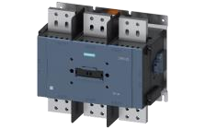
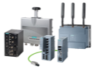
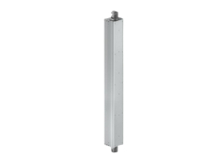


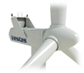
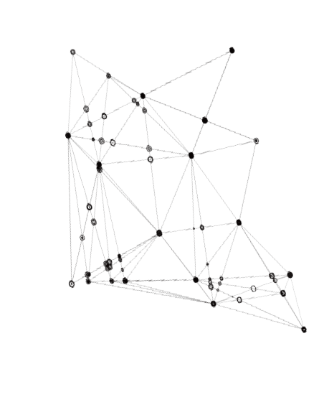
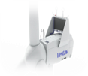
Revenue Synergies From Economies of Scale
By merging with Siemens, Vestas can offer smarter wind turbine solutions
Smart solutions
Combined Revenue with Synergies
5,885
By Leveraging Siemens Digital Industries and Smart Infrastructure offerings, Vestas will be able to provide a premier suite of Wind offerings
Vestas would be able to increase their product offering beyond turbines and blades by offering smart solutions such as communication infrastructure, smart breakers, and wiring
By offering more solutions for wind there is more opportunity for revenue growth
140,000
120,000 ₉₇₅
100,000
80,000
60,000
40,000
20,000
--
2,595
4,423
22,611
In $ Mm
16,421
18,572
21,002
95,088.00
81,062
85,234
89,569
Outstanding customer base
Siemens outstanding customer base presents a great opportunity for cross selling with Vestas
Many of Siemens customers are focused on decarbonization initiatives, by having access to the Vestas platform they can further these initiatives
Furthermore, Siemens customers can cross sell to Vestas
2023 2024 2025 2026
Siemens Revenue Vestas revenue Revenue synergies
Select Customer Additions
Emphasis on reducing emissions
Being able to efficiently cross sell Vestas smart wind turbines to these companies could greatly grow revenues
These heavily industrial capital goods manufacturers would greatly benefit by having the capability to efficiently power their powerplants using Siemens and Vestas wind turbines
All of the select customer additions highlighted to the right have outlined net zero emissions plans
Interconnectivity
Smart Infrastructure
Advancing IOT wind solutions with product synergies
Siemens product offering in the smart infrastructure segment enables interconnectivity and efficiency to wind developers
Benefits include turbine-to-turbine communication, predictive maintenance, and instant data analysis
By streamlining their offerings, the combined company could be the preeminent smart turbine manufacturer
Vestas’ Offerings
Premier Smart Product
Source: (Bloomberg, 2023), (FactSet, 2023)
48
Executive _{S}S_{u}u_{m}m_{m}m_{a}a_{ry}ry
Industry _{A}A_{n}n_{a}a_{ly}ly_{s}s_{is}is
Company O_{O}v_{v}e_{e}r_{r}v_{v}i_{i}e_{e}w_{w}
Financial O_{O}v_{v}e_{e}r_{r}v_{v}ie_{ie}w_{w}
Feasibility A_{A}n_{n}a_{a}ly_{ly}s_{s}is_{is}
Alternative S_{S}o_{o}lu_{lu}ti_{t}o_{io}n_{n}
Conclusion

Slide 49

Acquisition Feasibility Analysis

Slide 50



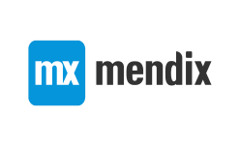


Siemens Past Acquisitions Favor Smaller, Tech Focused Companies
An acquisition of Vestas would be an outlier in both deal size and industry focus for Siemens
Siemens major acquisitions 2018-present in millions of dollars
Est. $30,000
Inordinate deal size
Siemens has made smaller, targeted acquisitions related to enterprise technology
Siemens has not completed an acquisition with total consideration over
~$2bn for the past five years
Siemens boasts a dividend yield of 3.03% as returning capital to their shareholders is a key strategy of theirs
With that in mind, acquiring vestas at a
$30bn valuation, roughly 20% of Siemens total market cap, would not be prudent of management
+1,500%
$2,000
$1,800
$1,600
$1,778.2
$1,400
$1,200
Wrong industry focus
Siemens past acquisitions were focused on tech-enabled solutions for industry
$1,000
$800
Mendix: Enterprise app development
Corindus: Vascular robotics
Supplyframe: Design-to-source intelligence solution
Sqills: Public transportation optimization
Dude Solutions: Asset management software
$576.9
$600
$803.5
$400
$598.3
$200
$550.0
Vestas is a large capital goods
manufacturer; this is in stark contrast to siemens acquisition strategy
$0
2018
2019
1H 2021
2H 2021
2022
2023
Source: (Annual Report, (Siemens, 2022), (Bloomberg, 2023)
Note: Expressed in USD with a conversion rate of 0.94 as of 2/20/23
50
Executive _{S}S_{u}u_{m}m_{m}m_{a}a_{ry}ry
Industry _{A}A_{n}n_{a}a_{ly}ly_{s}s_{is}is
Company O_{O}v_{v}e_{e}r_{r}v_{v}i_{i}e_{e}w_{w}
Financial O_{O}v_{v}e_{e}r_{r}v_{v}ie_{ie}w_{w}
Feasibility A_{A}n_{n}a_{a}ly_{ly}s_{s}is_{is}
Alternative S_{S}o_{o}lu_{lu}ti_{t}o_{io}n_{n}
Conclusion

Slide 51














Vestas and Siemens Strategies Don’t Align
Siemens already divested from the wind space, recognizing more growth in other areas
The gusts of wind were too strong for Siemens’ business model
In 2020, Siemens spun off their energy business which resulted in
Siemens Gamesa, a manufacturer of wind turbines
On January 25th of this year, Siemens Gamesa was delisted from the CNMV due to serious financial challenges facing the wind industry
These challenges include but are not limited to higher input prices, supply chain constraints, and lower order volumes
Turbine orders across the sector slowing down
Global installed natural gas generation capacity outlook 2020-2050
2,450
Capacity in gigawatts (GW)
2,350
2,250
2,150
Cheaper natural gas de-incentivizes investment in wind
2,050
1,950
Vestas’ projected orders
1,850
(25%)
Slowing turbine orders for Vestas, Siemens Gamesa’s
1,750
19,000
17534
2020A 2025E 2030E 2035E 2040E 2045E 2050E
17,000
16789
closet comp does not bode
well for broader industry
Greater natural gas supply will result in lower prices, making investments into wind power less attractive, especially in a high interest rate environment
In $ thousands
15,000
13203
13,000
13001
13043
Siemens divesting from other capital goods manufacturers, re-evaluating strategy
Siemens strategy has changed in the past 3 years as they have let divisions have more freedom while
still realizing accretive synergies
11956
11,000
9,000
This means building more exposure to automation, software building technologies, and public transport/mobility
Siemens has shown this change of strategy by divesting their exposure to capitally intensive heavy industries as shown in the timeline below
Viewing Siemens through this framework makes Vestas seem like an unusual target given their current strategy
7,000
5,000
2019A 2020A 2021A 2022E 2023E 2024E
Slowing turbine orders reflecting lower demand globally for wind power, showing a shift back to traditional fossil fuels or favoring other sources of alternative energy
Turbine orders may be buoyed by the IRA in the United States, however, the near zero interest rate environment of late 2020 to early 2021 may have boosted turbine sales, indicating a slight bubble
Source: (Annual Report (Siemens, 2022)), (Annual Report (Vestas, 2022)), (Bloomberg, 2023)
2020 2023
Siemens spun-off their Gas & Power segment to create the independent company, Siemens Energy
Clean exit from Valeo Siemens JV – Valeo bought the remaining stake in the JV
POC divests Siemens Parcel Logistics business for a post-tax gain of $0.8bn
Atlantia agrees to acquire Siemens Yunex for $1.1Bn
Executive _{S}S_{u}u_{m}m_{m}m_{a}a_{ry}ry
Industry _{A}A_{n}n_{a}a_{ly}ly_{s}s_{is}is
Company O_{O}v_{v}e_{e}r_{r}v_{v}i_{i}e_{e}w_{w}
Financial O_{O}v_{v}e_{e}r_{r}v_{v}ie_{ie}w_{w}
Feasibility A_{A}n_{n}a_{a}ly_{ly}s_{s}is_{is}
Alternative S_{S}o_{o}lu_{lu}ti_{t}o_{io}n_{n}
Conclusion
51

Slide 52



Siemens Downgrade Risk Post-Vestas Acquisition
Siemens faces massive downgrade risk in almost every acquisition debt financing scenario
A1
Siemens’ Credit Rating
1.9x
A+
If Siemens were to acquire Vestas at the below levels of debt, the company would be at risk of being downgraded by Moody’s and S&P Global
1.6x
100% Debt
Pro Forma Moody's-adjusted EBITDA Breakdown FY | 2022
Reported pro forma pre-tax income | 5,502
Add back Interest expense | 689
Add back D&A | 3,609
Reported pro forma EBITDA | 9,800
Equity income adjustment | 2,085
SFS adjustment | -1,135
Pension adjustment | -17
Unusual items | -1,014
Adjusted pro forma EBITDA | 9,719
50% Debt
Pro-Forma Moody's-adjusted EBITDA Breakdown FY | 2022
Reported pro forma pre-tax income | 5,502
Add back Interest expense | 689
Add back D&A | 3,609
Reported pro forma EBITDA | 9,800
Equity income adjustment | 2,085
SFS adjustment | -1,135
Pension adjustment | -17
Unusual items | -1,014
Adjusted pro forma EBITDA | 9,719
25% Debt
Pro-Forma Moody's-adjusted EBITDA Breakdown FY | 2022
Reported pro forma pre-tax income | 5,502
Add back Interest expense | 689
Add back D&A | 3,609
Reported pro forma EBITDA | 9,800
Equity income adjustment | 2,085
SFS adjustment | -1,135
Pension adjustment | -17
Unusual items | -1,014
Adjusted pro forma EBITDA | 9,719
Moody's-adjusted Debt Breakdown FY | 2022
Total unadjusted debt | 50,636
100% Debt financing of Vestas | 30,000
Pension adjustment | 1,979
Other standard adjustments | -30,827
Total adjusted pro forma debt | 51,788
Moody's adjusted pro forma debt to EBITDA | 5.3x
Moody's-adjusted Debt Breakdown FY | 2022
Total unadjusted debt | 50,636
50% Debt financing of Vestas | 15,000
Pension adjustment | 1,979
Other standard adjustments | -30,827
Total adjusted pro forma debt | 36,788
Moody's adjusted pro forma debt to EBITDA | 3.8x
Moody's-adjusted Debt Breakdown FY | 2022
Total unadjusted debt | 50,636
25% Debt financing of Vestas | 7,500
Pension adjustment | 1,979
Other standard adjustments | -30,827
Total adjusted pro forma debt | 29,288
Moody's Adjusted pro forma Debt to EBITDA | 3.0x
Moody’s range for global industrials scorecard range for Debt/EDBITDA is 1.6x - 1.9x for an A rating
DOWNGRADE to Baa3
Current: 1.9x Proposed: 5.3x
DOWNGRADE to Baa2
Current: 1.9x Proposed: 3.8x
DOWNGRADE to Baa2
Current: 1.9x
Aaa - Aa A
Source: (Moody’s, 2022), (S&P Global, 2022)
Aaa - Aa
A
Aaa - Aa A
Proposed: 3.0x
Note: Expressed in USD with a conversion rate of 0.94 as of 2/20/23
52
Executive _{S}S_{u}u_{m}m_{m}m_{a}a_{ry}ry
Industry _{A}A_{n}n_{a}a_{ly}ly_{s}s_{is}is
Company O_{O}v_{v}e_{e}r_{r}v_{v}i_{i}e_{e}w_{w}
Financial O_{O}v_{v}e_{e}r_{r}v_{v}ie_{ie}w_{w}
Feasibility A_{A}n_{n}a_{a}ly_{ly}s_{s}is_{is}
Alternative S_{S}o_{o}lu_{lu}ti_{t}o_{io}n_{n}
Conclusion

Slide 53




Foreign Exchange Risk
By acquiring Vestas, Siemens faces potential currency risk that is typically present in cross-border transactions
Siemens FX risk
Siemens’ principal currency is the Euro, but the company transacts in U.S. Dollar, the British pound, and emerging market currencies such as the Chinese yuan, exposing the company to currency risk The company consolidated statements are expressed in Euro, but for the beginning of March 2023 the statements were converted in US Dollar applying an exchange rate of €0.94 = $1.00 This can cause unalignment in financial statements due to fluctuating exchange rates Fluctuating rates can also affect interest rates in the deal, which can make debt financing more costly and increase the difficulty of generating returns
Managing FX Risk
Vestas FX risk
Most prevalent FX exchange rates
Vestas’ principal currency is the Danish Krone, but most of its sales are done in USD and EUR
Vestas’ currency exposure in USD has decreased as a result of increased sourcing of materials and components in USD
Because Vestas is a project-based business, risk exposures to specific foreign currencies change each year based on which geographical areas in which Vestas has activities
Vestas’ Euro exchange rate risk is low due to Denmark’s fixed exchanged rate policy towards the Euro, but transactional risk remains due to potential exchange rate fluctuations
7.48
7.46
7.44
7.42
7.40
7.38
EUR/DKK
F-20 A-20 F-21 A-21 F-22 A-22 F-23
1.30
1.20
1.10
1.00
0.90
EUR/USD
F-20 A-20 F-21 A-21 F-22 A-22 F-23
Acquisition cost scenario analysis at $35.81 per share
Siemens uses the following hedge accounting method to prevent FX risk:
Bear case
$36.28B
EUR/DKK = 7.48
Base case
$36.09B
EUR/DKK = 7.44
Bull case
$35.99B
EUR/DKK = 7.42
Siemens Hedge Accounting Method | Millions of euros |  | Millions of U.S. dollars
 | 2021 | 2022 | 2022
Effects of changes in exchange rates on cash and cash equivalents | 204 | 679 | 714
Change in cash and cash equivalents | (4,509) | 927 | 975
Cash and cash equivalents at beginning of period | 14,054 | 9,545 | 10,035
Less: Cash and cash equivalents of assets classified as held for disposal and discontinued operations at end of period | 0 | (7) | (7)
Cash and cash equivalents at end of period | 9,545 | 10,465 | 11,002
To hedge FX risk, Siemens has employed forward currency contracts, but Siemens
should use a deal-contingent FX hedge to mitigate exposure to variability
Because the principal currencies of Siemens and Vestas differ, foreign exchange risk can potentially affect valuations of the deal
It is assumed that Vestas’ equity holders would like to be paid in Danish kroner. To mitigate any currency fluctuation, Siemens would issue notes in the Nasdaq Copenhagen to raise the funds necessary to finance the transaction
Interest and amortization expenses would be covered with the cash flows generated by the integration of Siemens’ and Vestas’ wind power infrastructure
A deal-contingent FX hedge combines the standard forward currency forward contract with an FX option to lock in a forward rate and mitigate price volatility risk
Vestas employs a hedge accounting model and applies the following sensitivity assumption to foreign exchange rates movements on USD and EUR to reduce risk:
Vestas FX Risk Sensitivity Analysis (mEUR) |  | 2021 |  | 2022
Foreign Currency Risk | Change | Effect on profit/(loss) before tax | Effect on equity before tax | Effect on profit/(loss) before tax | Effect on equity before tax
USD | 10% | (20) | 146 | (49) | 159
Source: (Annual Report (Siemens, 2022)), (Annual Report (Vestas, 2022)), (Danmarks National Bank, 2023), (European Central Bank, 2023), (Statistics Denmark, 2023) Note: Expressed in USD with a conversion rate of 0.94 as of 2/20/23
53
Executive _{S}S_{u}u_{m}m_{m}m_{a}a_{ry}ry
Industry _{A}A_{n}n_{a}a_{ly}ly_{s}s_{is}is
Company O_{O}v_{v}e_{e}r_{r}v_{v}i_{i}e_{e}w_{w}
Financial O_{O}v_{v}e_{e}r_{r}v_{v}ie_{ie}w_{w}
Feasibility A_{A}n_{n}a_{a}ly_{ly}s_{s}is_{is}
Alternative S_{S}o_{o}lu_{lu}ti_{t}o_{io}n_{n}
Conclusion

Slide 54
















ESG Implications
ESG standards have the potential to impact Siemens’ acquisition of Vestas
Siemens has strong ESG goals…
Siemens DEGREE framework sets clear measurable ambitions
Net Zero operations by 2030, with 55% emissions
reduction by 2025 and 90% by 2030
Striving to train 100% of employees people on Siemens’ Business Conduct Guidelines every three years
ESG-secured supply chain based on supplier commitment to the Supplier Code of Conduct
Next-level robust eco-design for 100% of relevant Siemens product families by 2030
30% female share in top management by 2025
Access to employee assistance program: maintain high level and expand globally to 100% by 2025
… and it shows through their achievements
Post merger ESG implications
The proposed acquisition would be massively ESG accretive as both companies ESG goals align almost perfectly. It is possible that the merger could boost Siemens ESG score considering the amount of ESG synergies
ESG targets
AA
Constant leader for six years
Constituent for EUROZONE since 2020
Part of the FTSE4Good index family
80
Points
PREMIUM
A-
Carbon Neutral by 2030
2022: 339,000t
2022: 100,000t
2030: 0t
2030: 0t
2nd in Industrials industry for 20 years
No. 1 in Siemens industry group
Over 10 years at leadership level
Net zero supply chain
2022: 8,098,000t
2022: 6.46 kg/MWh
Vestas’ ESG initiatives
A - Materials efficiency
B - Emissions
A B C C - Waste management
D - Occupational health and safety
^{D E} E - Supply chain
^{Crucial} F - Product health and safety
G - Community relations
H - Broader environment
I - Diversity and inclusion
J - Business ethics
K - Stakeholder dialogue
L - Regulatory and legal
M - Human rights
N - Labor conditions
O - Ecological impact of project development
P - Employee engagement
Q - Talent attraction and retention
R - Critical incident risk management
S - Corporate governance
T - Responsible tax
U - Water management
0: Not relevant
1: Of little importance
2: Somewhat important
3: Important
4: Very important
5: Critical
Feasibility A_{A}n_{n}a_{a}ly_{ly}s_{s}is_{is}
2030: 0t
2030: 3.75 kg/MWh
External assessment (Impact on stakeholders)
5
K L
H I
Opportunities for women
Environmental
Using nature-based solutions so wind farms can have a net-positive biodiversity impact
30%
30%
4
R
M N
Very important
F G
By 2030
By 2030
Social
Become the safest, most inclusive, and most socially responsible company
3
S
Important
O P Q
J
Acquisition gives Siemens access to
Vestas’ quality memberships
2
T U
Governance
Strengthening policies, processes, training, and communication around business to foster integrity
1 2 3 4
5
Internal assessment (Impact on business)
Source: (Sustainability Report (Siemens, 2022)), (Sustainability Report (Vestas, 2022))
Executive _{S}S_{u}u_{m}m_{m}m_{a}a_{ry}ry
Industry _{A}A_{n}n_{a}a_{ly}ly_{s}s_{is}is
Company O_{O}v_{v}e_{e}r_{r}v_{v}i_{i}e_{e}w_{w}
Financial O_{O}v_{v}e_{e}r_{r}v_{v}ie_{ie}w_{w}
Alternative S_{S}o_{o}lu_{lu}ti_{t}o_{io}n_{n}
Conclusion
54

Slide 55
Financing Scenario Analysis
After analyzing three different structures for this acquisition, none are feasible or logical
Debt financing
Equity financing
Equity/cash hybrid
By financing this acquisition with 40% debt and 60% equity, there would be dilutive to EPS by 1.2%
By using a combination of debt and equity you reap the benefits of both. Retaining ownership in the company through issuing equity but also keeping your cost of capital with debt financing
While this structure is the most favorable to the other proposed structures, the deal size is still too large to mitigate the negatives with any structure
By financing this acquisition with 100% debt using 20- year notes marked at SOFR plus 1.00 (6.60%) would have massive implications that would negatively impact Siemens’ leverage ratios
Referring to the slide 52, we can see that Siemens Adjusted Debt/EBITDA ratio would increase by 4.1x resulting in their credit worthiness being downgraded to Baa3
Due to these reasons, debt financing is infeasible
By financing this acquisition with 100% equity, Siemens would have to issue 211 million shares resulting in a 1.2% dilutive effect to pro forma EPS
Equity financing in the green energy sector is exceptionally expensive. Green & renewable energy companies have an average cost of equity of 13.39% vs the total market average of 10.75%
Current market conditions have made equity less attractive to individual investors, favoring bonds
Due to these reasons equity financing is not ideal
Shareholder dilution not affected
Tax deductibility of interest expense poses a major benefit to book taxes after D&A write- ups
The resulting debt would be cheaper than equity
Siemens is a leader in the market, leading them to holding negotiating power with lenders
Reduced default risk on massive debt load
Controlling stake is maintained as no new shares are issued
WACC is not significantly affected as debt and equity considerations are not stretched to their limits
Benefits
Credit rating is not affected by changes to
Debt/EBITDA ratio
No institution holds >3.5% of shares, meaning dilutive effect is not massive for a single institution
Sizeable interest payments avoided
Vestas’ shareholders avoid double taxation
✗ Credit rating downgrade is almost certain
✗ Significant leverage to acquire a business whose projects yield minimal returns
✗ Default risk is significantly raised – could ruffle the feathers of investors on both sides of the debt and equity aisles
✗ In the scenario with the lowest cash consideration of
1%, this requires Siemens to hand over $304 MM
✗ Debt is necessary for this deal as Siemens does not have enough cash on hand to purchase Vestas with cash alone
✗ If Siemens used all their cash (~$10 Bn), they would still need to raise almost ~$20Bn to complete the deal
✗ ~21% of shares are held by institutions leaving many parties to be negotiated with
✗ 100% equity would require issuing 211 Mm shares to be issued – roughly 26% of current shares outstanding
✗ In a 60/40 consideration, Siemens would need to issues 84 MM shares to acquire Vestas
Risks
Source: (Damodaran, 2022)
Executive _{S}S_{u}u_{m}m_{m}m_{a}a_{ry}ry
Industry _{A}A_{n}n_{a}a_{ly}ly_{s}s_{is}is
Company O_{O}v_{v}e_{e}r_{r}v_{v}i_{i}e_{e}w_{w}
Financial O_{O}v_{v}e_{e}r_{r}v_{v}ie_{ie}w_{w}
Feasibility A_{A}n_{n}a_{a}ly_{ly}s_{s}is_{is}
Alternative S_{S}o_{o}lu_{lu}ti_{t}o_{io}n_{n}
Conclusion
55

Slide 56
Siemens + Vestas | Merger Model
An acquisition of Vestas would be dilutive to Siemens EPS
Company profile
Accretion/dilution analysis
Siemens Financial Profile |  | Accretion/Dilution Analysis
Fully Diluted Shares Outstanding | 800 | Acquirer Standalone Net Income | $6,936 |  | Target Standalone Net Income | $2,002
Current Share Price | $153.94 | % Tax Rate | 22.0% |  | % Tax Rate | 22.0%
Equity Value | $123,149 | Earnings Before Taxes (EBT) | $8,893 |  | Earnings Before Taxes (EBT) | $2,566
Forecasted Earnings Per Share (EPS) _{t + 1} | $8.67
P/E Multiple 17.8x |  | Pro Forma Financials |  |  | Pro Forma EPS
Vestas Financial Profile
Fully Diluted Shares Outstanding | 1,006
Current Share Price | $29.31
Equity Value | $29,486
Forecasted Earnings Per Share (EPS) _{t + 1} | $1.99
P/E Multiple | 14.7x
Consolidated EBT | $11,459 | Pro Forma Net Income | $8,108
Less: Interest Expense and Financing Fees | (829) | Pre-Deal Acquirer Shares Outstanding | 800
Plus: Synergies, net | 400 | Plus: New Shares Issuances | 149
Less: Incremental Depreciation | (636) | Pro Forma Diluted Shares | 949
Pro Forma Adjusted EBT | $10,394
Less: Taxes | (2,287) | Pro Forma EPS | $8.54
Pro Forma Net Income | $8,108 | % Accretion / (Dilution) | (1.5%)
Transaction and financing assumptions
Dilutive to pro-forma EPS by (1.5%)
Transaction Assumptions
Form of Consideration
Purchase Price Accounting
Offer Price Per Share
% Offer Premium
$38.10 30.0%
% Stock
% Cash
60.0%
40.0%
Offer Value
Less: Net Tangible Book Value
$38,332 (2,000)
Offer Value $38,332
Purchase Premium
Less: PP&E Write-Up Less: Intangibles Write-Up
Plus: Deferred Tax Liability (DTL)
$36,332
(9,083)
(3,633)
2,798
Cash Consideration (All-Debt Funded)
Stock Consideration
Offer Value
% Cash
$38,332 40.0%
Offer Value
% Stock
$38,332 60.0%
Total Debt Financing
Financing Fee
Financing Fee % Total Debt
$15,333
$1,024 6.7%
Stock Consideration
Number of Acquirer Shares Issued
$22,999
149
Goodwill Created $26,414
Asset Write-Ups
% Allocation to PP&E Useful Life Assumption
25.0%
20 Years
Borrowing Term | 20 Years |  | Deal Assumptions |  |  | Incremental Depreciation | $454
Financing Fee Amortization | $51 |  | Synergies, net | $400 |  | % Allocation to Intangibles | 10.0%
% Interest Rate | 5.1% |  | Transaction Fees | $958 |  | Useful Life Assumption | 20 Years
Annual Interest Expense | $777 |  | Transaction Fees % Offer Value | 2.5% |  | Incremental Amortization | $182
Source: (Bloomberg, 2023)
Executive _{S}S_{u}u_{m}m_{m}m_{a}a_{ry}ry
Note: Expressed in USD with a conversion rate of 0.94 as of 2/20/23
Industry _{A}A_{n}n_{a}a_{ly}ly_{s}s_{is}is
Company O_{O}v_{v}e_{e}r_{r}v_{v}i_{i}e_{e}w_{w}
Financial O_{O}v_{v}e_{e}r_{r}v_{v}ie_{ie}w_{w}
Feasibility A_{A}n_{n}a_{a}ly_{ly}s_{s}is_{is}
Alternative S_{S}o_{o}lu_{lu}ti_{t}o_{io}n_{n}
Conclusion
56

Slide 57

Alternative Solution

Slide 58





Vestas and Siemens Strategies Don’t Align
Siemens already divested from the wind space, recognizing more growth in other areas
Relevance & rationale Product alignment Strategic feasibility
Financial feasibility
Decision
Premier brand with large customer base already in place
Generac is currently expanding their smart grid solutions moving away from C&I products
~$10Bn valuation: too large
Too much fossil fuel exposure in large generator segment
~$28 Bn valuation: too large
Capitally intensive business much like Vestas
Manufacturing of solar panels could be optimized with Siemens System
Solar power is growing to be a more attractive vertical
Large exposure in residential solar installation and maintenance
Siemens metering technology would be a great synergy
~$5 Bn valuation attractive, but not best strategic fit
Siemens focuses on industry over residential
Direct competitor with Fluence – a Siemens investment
Combining the two would make them the market leader in energy storage
~$1Bn valuation in line with precedents
Complimentary to Siemens strategy
Source: (Bloomberg, 2023)
Executive _{S}S_{u}u_{m}m_{m}m_{a}a_{ry}ry
Industry _{A}A_{n}n_{a}a_{ly}ly_{s}s_{is}is
Company O_{O}v_{v}e_{e}r_{r}v_{v}i_{i}e_{e}w_{w}
Financial O_{O}v_{v}e_{e}r_{r}v_{v}ie_{ie}w_{w}
Feasibility A_{A}n_{n}a_{a}ly_{ly}s_{s}is_{is}
Alternative S_{S}o_{o}lu_{lu}ti_{t}o_{io}n_{n}
Conclusion
58

Slide 59

















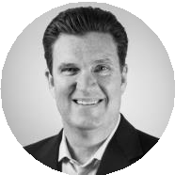
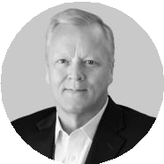
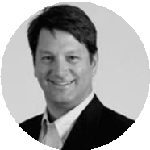









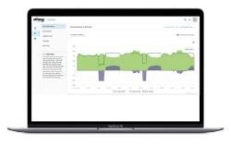









Stem, Inc. Overview
A world leader in energy solutions with successful technology platform and proven management
Overview of Stem, Inc.
Front of the Meter vs. Behind the Meter
Front of the Meter Customers
Stem, Inc. is a leader in AI-driven clean energy solutions
The company provides customers with digitally integrated energy storage systems that include hardware that aid with data collection and real-time operation
Athena is an AI platform that helps to reduce customer energy costs through time-of use and demand change management innovations and a network of VPP’s
Generation
Transmission
Distribution
Residential + C&I Microgrid
Behind the Meter (BTM)
Front of the Meter (FTM)
Revenue in $ thousands
$400,000
$300,000
$200,000
$100,000
$0
Revenue outside the U.S.
362,980
Behind the Meter Customers
grew 6416% between ‘21 to
‘22
127,371
John Carrington
CEO
Michael Carlson
COO
Bill Bush
CFO
36,307
2020
Hardware
2021 2022
Services and other
Athena - a leading energy performance AI platform…
Uses advanced AI to optimize customer operations by automatically controlling system batteries
..that includes time-of-use arbitrage
 | Energy + Solar Storage + Demand Response Hardware segment with additional software benefits to act as a facilities manager
 | Athena Platform Stem’s leading AI platform combined with the PowerTrack offering delivers enhanced solar project returns
 | Commercial EV Charging Targeting commercial vehicle fleets to aid the clean energy transition and reduce the share of greenhouse gas emissions in the U.S.
 | Utility Bill Optimization Identifying best times to consume stored energy and release energy produced back into the grid – reducing expense and increasing profitability
 | Sustainability A strong value-proposition for companies looking to maximize their ESG objectives. Stem’s offerings help develop evidence of sustainability leadership
Will automatically switch to…
Athena statistics
30 of the Fortune 500 use Athena
40+ Utilities
31+ MM runtime hours
>200,000 sites in 50+
countries
Identifies and predicts the best times to store energy and release it back into the grid
Maximize savings by lowering demand and energy charges
Battery Storage
Onsite Generation
Grid Power
Source: (10-K (Stem, Inc. 2022)), (Climate Tech VC, 2022), (Investor Day (Stem, Inc. 2022)), (Bloomberg, 2023) (Stem, Inc. 2023)
Executive _{S}S_{u}u_{m}m_{m}m_{a}a_{ry}ry
Industry _{A}A_{n}n_{a}a_{ly}ly_{s}s_{is}is
Company O_{O}v_{v}e_{e}r_{r}v_{v}i_{i}e_{e}w_{w}
Financial O_{O}v_{v}e_{e}r_{r}v_{v}ie_{ie}w_{w}
Feasibility A_{A}n_{n}a_{a}ly_{ly}s_{s}is_{is}
Alternative S_{S}o_{o}lu_{lu}ti_{t}o_{io}n_{n}
Conclusion
59

Slide 60
Powering Up: Decentralized Grids
The vision for decentralized grids has evolved over recent decades, but now the grid is taking the main stage
Even in 2009, a shift to decarbonized grid was a focus for the future…
…that focus opened doors for today…
…and keeps them open for tomorrow.
Industries leading in project development
The Smart Grid Investment Grant aimed to accelerate the modernization of the nation’s electrical grid with an
$8 Bn investment
US microgrid market reached 10 GW in Q3 ’22
For comparison, 1H ‘20 had only
60 MW connected
15 In gigawatts (GW)
10
3
In planning
7
1
Commercial & Industrial
2
Government
5
In operation
“Electric system will move from a centralized, producer-controlled network to a less centralized, more consumer-interactive, more environmentally responsive model.” – U.S. DoE
0
New microgrid installations in the US…
3
4
Education
5%
10%
3%
Residential
$8
Billion USD
In megawatts (MW)
1,000
800
600
400
200
0
Projected global microgrid market size…
$44
13%
30%
39%
$50
$40
$30
$20
$10
$0
$36
In $ Bn
$22
$26
$30
$19
Cross Cutting Projects
Advanced Metering
Distribution
Transmission
Computer Systems
Equipment Manufacturing
2023E 2024E 2025E 2026E 2027E 2028E
Operational
Planned
Forecast
Decarbonizing the grid could result in significant solar output…
Investment in digital infrastructure bodes well for Stem’s Athena software
$60
Grid investment needs to double by 2030 to correspond with Net Zero scenarios…
$800
3500
3000
2500
2000
1500
1000
500
0
3000 GW
Installed capacity (GW_{AC})
by 2050
$50
$40
$30
$20
$10
$0
$600
In $ Bn
In $ Bn
219
$400
1000 GW
132
_{550 GW} by 2035
_{225 GW} by 2030
$200
81
231
80
by 2025
$0
148
2015-2021 2022-2030
2015 2020 2025 2030 2035 2040 2045 2050 2055
Decarbonized Grid Decarbonized Energy System
2015
2016 2017
2018
2019
Automation systems
Analytics EV charging
2020
2021
Smart meters
Advanced economies China Emerging market
Networking and communications Transformers
Source: (IEA (2), 2022), (Precision Business Insights, 2022), (SmartGrid.gov, 2022), (Wood Mackenzie (3), 2022), (Solar Energy Technologies Office, 2023), (Statista, 2023)
60
Executive _{S}S_{u}u_{m}m_{m}m_{a}a_{ry}ry
Industry _{A}A_{n}n_{a}a_{ly}ly_{s}s_{is}is
Company O_{O}v_{v}e_{e}r_{r}v_{v}i_{i}e_{e}w_{w}
Financial O_{O}v_{v}e_{e}r_{r}v_{v}ie_{ie}w_{w}
Feasibility A_{A}n_{n}a_{a}ly_{ly}s_{s}is_{is}
Alternative S_{S}o_{o}lu_{lu}ti_{t}o_{io}n_{n}
Conclusion

Slide 61

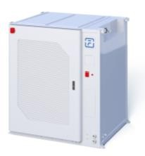




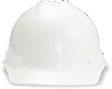

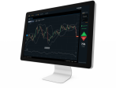
Siemens’ Fluence and Stem | A Perfect Fit
By acquiring Stem, Siemens’ Fluence would become the biggest player in North American battery storage
Installed U.S. Capacity (in MW)
0 200 400
Both Fluence and Stem have a large exposure to CA and TX, which represent some of the largest end markets in the U.S.
Siemens’ exposure to U.S. battery storage
Siemens Acquired Fluence through a JV in June of 2017
600
California
535.3
Fluence is a global provider of energy storage products, services, and artificial intelligence
Fluence Cube technology combined with their Gridstack AI helps energy providers and producers in flexing peak capacity, allowing producers to arbitrage prices
Texas
223.1
Post merger synergies
GW Deployed
Illinois
132.7
4.0
3.5
3.0
2.5
2.0
1.5
1.0
0.5
0.0
Massachusetts
70.9
111%
Fluence Systems are completely modular
Fluence business segments
Which makes them extremely scalable
Hawaii
63
West Virginia
49.5
Components (including batteries), professional services, and labor required to manufacture, assemble, and install products
Energy Storage Products
Fluence Stem
GW Assets Managed
Pro-forma
Recurring operational and maintenance services that energy storage products require, management services that are provided by third parties when asset owners outsource the operations of their systems,
By Acquiring Stem, Siemens Fluence would grow their total North American Gigawatts Deployed by 111%, making it the largest pure play energy storage company in North America
18.0
16.0
14.0
12.0
10.0
8.0
6.0
15.7
13.7
Services
and the provision of ESaaS
Operating systems, applications, such as trading platforms that allow system owners to manage their grid participation. These trading platforms can be deployed on both energy storage assets and
By Acquiring Stem, Siemens Fluence will integrate their already prolific Mosaic software, connecting both customer bases and integrating them onto the same system
4.0
2.0
0.0
2.0
Digital Apps & Solutions
renewable and conventional generation assets
Source: (EIA.gov, 2021), (Bloomberg, 2023)
Athena
Alternative S_{S}o_{o}lu_{lu}ti_{t}o_{io}n_{n}
Mosaic
Pro-Forma
Executive _{S}S_{u}u_{m}m_{m}m_{a}a_{ry}ry
Industry _{A}A_{n}n_{a}a_{ly}ly_{s}s_{is}is
Company O_{O}v_{v}e_{e}r_{r}v_{v}i_{i}e_{e}w_{w}
Financial O_{O}v_{v}e_{e}r_{r}v_{v}ie_{ie}w_{w}
Feasibility A_{A}n_{n}a_{a}ly_{ly}s_{s}is_{is}
Conclusion
61

Slide 62



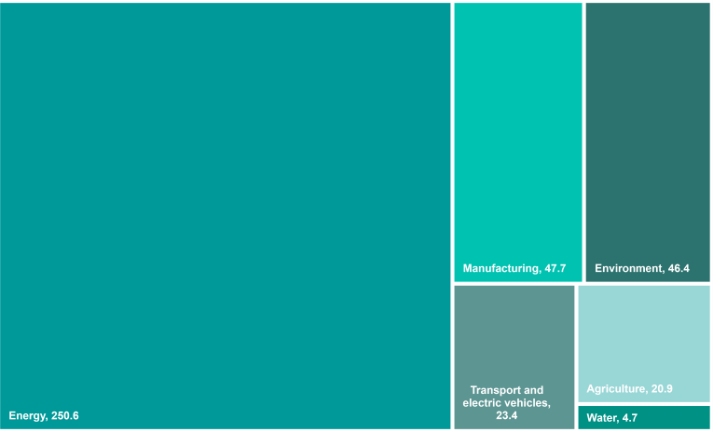
Stem Positioned Excellent to Reap IRA Benefits
IRA incentives outweigh those of the Green Deal
EU commission Grean Deal Industrial Plan
Predictable and simplified regulatory environment
The net zero industrial act will provide a supportive framework for industrial capacity goals by 2030 by reducing length of permitting process, reinforcing administrative capacity, and providing specific time limits
Complemented by the Critical Raw Materials Act which ensures sufficient access to key resources
Speeding access to financing
Allow ease of access for member states to support the deployment of all renewable energy sources by granting aid for less mature technologies and incentivize investment with higher aid ceilings to fast-track the green transition using national funding
EU budget will contribute through REPower (20 billion in grants, 225 billion in loans), InvestEU (372 billion) and EU Innovation Fund (40 billion)
Enhancing skills and open trade for resilient supply chains
European Pact for Skills now counts for 1,000 partners targeting to up/reskill 6m people
EU will continue to support relationships with trade partners, foster international
trade, increase free trade agreements, and establish a critical raw materials club
U.S. Inflation Reduction Act
The IRA is expected to catalyze investments in
domestic manufacturing capacity and innovation with the highest beneficiaries being
Energy and climate change funding in IRA
The IRA poses a competitive threat to the EU’s Green Deal Industrial Plan
IRA
Green Deal
13
Federal Options Loans
Total Spending
40
$394B
$309B
82
Grants
43
Tax Incentives, consumer
$394
Billion
Corporate Tax Credits
26%
tax credit
$216B
216
Tax Incentives, corporate
CapEx
Not Stated
10%
Stem will see a significant benefit from the IRA…
…in multiple areas of their business
Distribution of IRA incentives
In $ billion USD
Clean Vehicles, 4%
Transmission & Distribution, 1%
Standalone storage ITC - greenfield
Standalone storage ITC - retrofit
Solar production tax credit
Improves customer economics with 30 – 60% reduction in project costs
This results in massive demand for clean energy solutions from consumers
$6B potential AlsoEnergy storage retrofit opportunity in core markets
$20B for entire AlsoEnergy Portfolio
Athena + PowerTrack can enable 500+ bps improvement in project IRRs by electing PTC in lieu of ITC
Manufacturing, 19%
Power Generation, 45%
Building Efficiency & Clean Energy, 31%
Source: (Investor & Analyst Day (Stem, 2022)), (10-K (Stem Inc, 2023)), (McKinsey & Company (1), 2022)
62
Executive _{S}S_{u}u_{m}m_{m}m_{a}a_{ry}ry
Industry _{A}A_{n}n_{a}a_{ly}ly_{s}s_{is}is
Company O_{O}v_{v}e_{e}r_{r}v_{v}i_{i}e_{e}w_{w}
Financial O_{O}v_{v}e_{e}r_{r}v_{v}ie_{ie}w_{w}
Feasibility A_{A}n_{n}a_{a}ly_{ly}s_{s}is_{is}
Alternative S_{S}o_{o}lu_{lu}ti_{t}o_{io}n_{n}
Conclusion

Slide 63

Stem Revenue Build
Business segment and total revenue breakdown through 2028
Services and Other Revenue
400,000
Hardware Revenue Breakdown
1,200,000
350,000
343,309
1,000,000
963,679
306,526
830,758
762,163
$ in thousands
300,000
250,000
200,000
273,683
800,000
712,302
$ in thousands
642,872
202,729
600,000
501,069
150,000
108,180
400,000
310,837
100,000
52,143
59,115
200,000
50,000
0
20,463
106,908
15,645
20,662
2020A 2021A 2022A 2023E 2024E 2025E 2026E 2027E 2028E
0
2020A 2021A 2022A 2023E 2024E 2025E 2026E 2027E 2028E
Total Revenue Breakdown Derived From Each Segment
Total Revenue Breakdown
Total revenue is expected to grow across the projected 9-year period at a CAGR of 48.91% driven by heightened growth in both segments
Both hardware revenue and services revenue are forecasted to significantly increase at a CAGR of 53.26% and 40.94% respectively
Stem continues to highlight progress in the EV charging markets following its
partnership with ChargePoint
Given EV charging solutions can require systems sizes 2 – 5x larger, EV ventures are an important growth avenue
Software fees associated with these projects can be 2x larger than a BTM storage deployment
Successful cross-selling of AlsoEnergy customers for solar+storage applications
1,400,000
1,200,000
1,000,000
800,000
600,000
400,000
200,000
0
$ in thousands
2020A 2021A 2022A 2023E
Services and other revenue
2024E 2025E 2026E 2027E 2028E
Hardware revenue
Source: (Bloomberg,2023), (Cowen, 2023)
63
Executive _{S}S_{u}u_{m}m_{m}m_{a}a_{ry}ry
Industry _{A}A_{n}n_{a}a_{ly}ly_{s}s_{is}is
Company O_{O}v_{v}e_{e}r_{r}v_{v}i_{i}e_{e}w_{w}
Financial O_{O}v_{v}e_{e}r_{r}v_{v}ie_{ie}w_{w}
Feasibility A_{A}n_{n}a_{a}ly_{ly}s_{s}is_{is}
Alternative S_{S}o_{o}lu_{lu}ti_{t}o_{io}n_{n}
Conclusion

Slide 64







Valuation and Cost/Profit of Acquiring Stem (1/3)
Discounted cash flow analysis
Fiscal Year Fiscal Year End Date |  | 2021A 12/30/21 | 2022A 12/30/22 |  | 2023E 12/31/23 |  |  | 2024E 12/30/24 | 2025E 12/30/25 | 2026E 12/30/26 | 2027E 12/31/27 | 2028E 12/30/28
Revenue |  | 36 | 127 |  | 560 |  |  | 751 | 915 | 1,036 | 1,137 | 1,307
% growth |  |  |  | 1 |  | 339.8% |  | 34.1% | 21.8% | 13.2% | 9.8% | 14.9%
Adj. EBITDA |  | (45) | (57) |  | (8) |  |  | 48 | 113 | 199 | 269 | 340
% margin |  |  |  |  | (19.8%) |  |  | 71.2% | 113.4% | 128.3% | 74.1% | 60.7%
Depreciation and amortization |  |  |  |  | (54) |  |  | (65) | (75) | (78) | (92) | (101)
Stock-based compensation |  |  |  |  | 2 |  | (28) | (27) | (30) | (31) | (30) | (30)
EBIT |  | (83) | (131) |  | (91) |  |  | (45) | 8 | 91 | 147 | 209
Tax Rate |  | 0.0% | (10.9%) |  | (9.0%) |  |  | (9.0%) | 0.0% | 0.0% | 0.0% | 0.0%
EBIAT (NOPAT) |  | (83) | (145) |  | (99) |  |  | (49) | 8 | 91 | 147 | 209
Depreciation and amortization |  |  |  |  | 3 |  | 54 | 65 | 75 | 78 | 92 | 101
Working Capital Items: |  |  |  |  | (10) |  |  | 30 | 16 | 7 | 8 | 18
Unlevered CFO |  |  |  |  | (64) |  |  | 76 | 115 | 183 | 254 | 346
Capital Expenditures |  |  |  |  | (25) |  |  | (34) | (42) | (47) | (52) | (60)
Unlevered FCF |  |  |  |  | (90) |  |  | 42 | 73 | 135 | 202 | 286
% growth |  |  |  |  |  |  |  | (146.4%) | 76.6% | 84.5% | 49.4% | 41.5%
Discount factor |  |  |  |  | 181% |  |  | 281% | 381% | 481% | 581% | 681%
Assume cash flows are generated at:
Midperiod adjustment factor |  |  |  |  | 1.8 |  |  | 1.0 | 1.0 | 1.0 | 1.0 | 1.0
Present value of Unlevered FCF |  |  |  |  | (80) |  |  | 31 | 49 | 80 | 105 | 132
4
Additional Commentary
1
Significant growth projected due to the increased investment in solar energy and battery storage
Driven by hardware sales and technology related revenue in 2024
Stock-based compensation treated as an expense for DCF valuation
Stem, Inc. has a significant amount of SBC, including it in the valuation
3
Stem, Inc. has significant D&A expense driven by the energy storage systems that the company owns
Growth in D&A expected as the company continues to grow revenue
2
4
Midperiod adjustment factor used to calculate present value of FCF
Assumed cash flows collected in the middle of the period as opposed to the end
Source: (Bloomberg, 2023)
Executive _{S}S_{u}u_{m}m_{m}m_{a}a_{ry}ry
better determines the fair value of the company
Industry _{A}A_{n}n_{a}a_{ly}ly_{s}s_{is}is
Company O_{O}v_{v}e_{e}r_{r}v_{v}i_{i}e_{e}w_{w}
Financial O_{O}v_{v}e_{e}r_{r}v_{v}ie_{ie}w_{w}
Feasibility A_{A}n_{n}a_{a}ly_{ly}s_{s}is_{is}
Alternative S_{S}o_{o}lu_{lu}ti_{t}o_{io}n_{n}
Conclusion
64

Slide 65
Valuation and Cost/Profit of Acquiring Stem (2/3)
WACC and Capitalization
Cost of Capital Assumptions
Pre-tax cost of debt | 4.8%
Tax rate | 0.0%
Risk free rate | 3.9%
Beta | 2.1
Market risk premium | 5.9%
Cost of Debt
Perpetuity and Exit EBITDA Sensitivity Analysis
$7.89
2.0%
2.5%
3.0%
3.5%
4.0%
 | 13.5% | 6.57 | 6.95 | 7.36 | 7.81 | 8.31
 | 13.3% | 6.81 | 7.20 | 7.63 | 8.10 | 8.63
WACC: | 13.1% | 7.06 | 7.47 | 7.92 | 8.41 | 8.96
 | 12.9% | 7.31 | 7.74 | 8.21 | 8.74 | 9.32
 | 12.7% | 7.58 | 8.03 | 8.52 | 9.07 | 9.69
Pre-tax cost of debt Tax rate
4.8%
0.0%
Equity value per share
After-tax cost of debt 4.8%
Exit EBITDA Multiple
 | 7.8x | 8.8x | 9.8x | 10.8x | 12.8x
14.1% | 6.12 | 7.01 | 7.91 | 8.81 | 10.60
13.6% | 6.38 | 7.31 | 8.23 | 9.15 | 11.00
13.1% | 6.65 | 7.61 | 8.56 | 9.51 | 11.42
12.6% | 6.94 | 7.92 | 8.90 | 9.88 | 11.84
12.1% | 7.23 | 8.24 | 9.25 | 10.26 | 12.29
$8.26
Cost of Equity
Risk free rate Beta
Market risk premium
3.9%
2.1
5.9%
WACC:
Cost of Equity 16.1%
Cost of Capital (WACC)
Capital weights
Amount % of total
The Weighted Average Cost of Capital (WACC) represents return to lenders and shareholders
Stem’s WACC of 13.1% represents the required rate of return (discount rate) necessary for DCF analysis
This also represents the fact that the company must pay investors an average of $0.131 for every $1.00 received in funding
Market value of equity | 1,208.8 | 73.5%
Market value of net debt | 436.4 | 26.5%
Cost of capital (WACC) |  | 13.1%
Source: (Bloomberg, 2023)
Executive _{S}S_{u}u_{m}m_{m}m_{a}a_{ry}ry
Industry _{A}A_{n}n_{a}a_{ly}ly_{s}s_{is}is
Company O_{O}v_{v}e_{e}r_{r}v_{v}i_{i}e_{e}w_{w}
Financial O_{O}v_{v}e_{e}r_{r}v_{v}ie_{ie}w_{w}
Feasibility A_{A}n_{n}a_{a}ly_{ly}s_{s}is_{is}
Alternative S_{S}o_{o}lu_{lu}ti_{t}o_{io}n_{n}
Conclusion
65

Slide 66
Valuation and Cost/Profit of Acquiring Stem (3/3)
Fair enterprise value and football field
Enterprise to Equity Value Bridge Football Field
4000
30.00
3500
$3,540
88
524
25.00
$3,104
3000
20.00
18.02
2500
In $ Mm
2000 | Diluted shares outstanding:
 | 154,578
1500
1000 | Implied share price:
500 | $20.08
In $
15.00
11.42
10.00
8.96
Current Price
$7.82
5.00
6.65
7.06
5.72
0
0.00
DCF Value at 7.8x-12.8x Exit EBITDA Range
DCF Value at 2.0%-4.0% Perpetuity Range
52 Week Market High/Low
Enterprise Value
Cash
Debt
Equity Value
Current Enterprise Value: $3.540Bn
+ Cash and Cash Equivalents: $0.088
- Total Debt: $0.524Bn
Equity Value: $3.104Bn
Enterprise Value via Perpetuity Approach: $1.66Bn
Enterprise Value via Exit EBITDA Multiple Approach: $1.71Bn
Stem’s DCF outputs indicate the company is fairly valued in relation to its current market valuation
Source: (Bloomberg, 2023)
Executive _{S}S_{u}u_{m}m_{m}m_{a}a_{ry}ry
Industry _{A}A_{n}n_{a}a_{ly}ly_{s}s_{is}is
Company O_{O}v_{v}e_{e}r_{r}v_{v}i_{i}e_{e}w_{w}
Financial O_{O}v_{v}e_{e}r_{r}v_{v}ie_{ie}w_{w}
Feasibility A_{A}n_{n}a_{a}ly_{ly}s_{s}is_{is}
Alternative S_{S}o_{o}lu_{lu}ti_{t}o_{io}n_{n}
Conclusion
66

Slide 67













Post Acquisition Strategy
By focusing on decarbonization initiatives Siemens will be better positioned
Focusing on technology solutions for both commercial and residential
“I’m not sure I see and
Enhance AI capabilities through a combined APM platform
Capitalize on new solar markets
enduring moat”
“Could make utilities obsolete. We may not need to rely on them for power anymore.”
“Residential developers are better positioned to take over MFRE”
MA State goal of net-zero emissions by 2050
Athena
Combination
FluenceIQ
“The folks who weren’t true to their DNA like Stem/Viridity are now valuable companies
“I see lots of C&I solar developers/EPCs/asset- owners turning towards them”
Software integrated with solar energy systems
Lacks the functionality to interact with other renewable energy systems
Energy management in multiple clean energy markets
Combined AI with enhanced automatic bidding process
Advanced platform for solar, wind, and energy with value-add software applications
267 MW of storage assets under management
Northeastern America is set to be the next largest Solar Energy market in the United States
Due to long winters, and limited sunlight, the ability to store energy in these markets will fetch a premium
“The undervalued players are the building systems management/OEM companies
NY State Goal of 70 percent renewable electricity generation by 2030
Etc +
Building meaningful customer relationships to drive revenue growth in key areas
Diversifying revenue streams across essential business partners
$2,500
$2,000
Combined solutions position Stem + Fluence to be a clear leader in battery
Stem and Fluence have complimentary customers
$1,500
storage and APM
Stem captures consumer brands
Fluence is heavy in C&I
By combining both companies Siemens can have a great presence in battery storage
$1,000
$500
$0
2020A
2021A 2022A
Stem Fluence Pro-Forma
2023E
Source: (10-K (Stem, Inc. 2022)), (Investor Day (Stem, Inc. 2022)), (Suri, 2022), (Bloomberg, 2023), (Stem, Inc. 2023)
67
Executive _{S}S_{u}u_{m}m_{m}m_{a}a_{ry}ry
Industry _{A}A_{n}n_{a}a_{ly}ly_{s}s_{is}is
Company O_{O}v_{v}e_{e}r_{r}v_{v}i_{i}e_{e}w_{w}
Financial O_{O}v_{v}e_{e}r_{r}v_{v}ie_{ie}w_{w}
Feasibility A_{A}n_{n}a_{a}ly_{ly}s_{s}is_{is}
Alternative S_{S}o_{o}lu_{lu}ti_{t}o_{io}n_{n}
Conclusion

Slide 68

Conclusion

Slide 69



The Conclusion
Siemens should not acquire Vestas and rather opt for an acquisition that better aligns with its strategic initiatives
Product Integration
Financial Analysis
Synergistic Opportunities
Competing visions
Visions for both Siemens and Vestas revolve around the transition to renewable energy, but Siemens prioritizes smaller, more tech-focused businesses
Siemens divested from wind power when the company spun-off the Gas & Power segment in 2020 to form Siemens Energy
Acquiring Vestas would not align with the strategic goals of Siemens as the company tries to move away from capitally intensive businesses
Not fiscally responsible.
Vestas is a massive company. By moving forward with an acquisition of this size, Siemens would need to raise a significant portion of debt
Moody's range for global industrials scorecard range for Debt/EBITDA is 1.6x-1.9x for A+ rating
All scenarios where Siemens uses debt to finance this transaction leads to a credit rating downgrade ranging from Baa3 – Ba2
Wind blows!
Vestas primarily operates in onshore solutions (71.8% of revenues) and has made the decision to expand operation in offshore production
Europe has seen a significant downturn in demand for wind solutions and is looking to alternative renewable energy
As Vestas makes the transition to offshore, the company will experience difficulty competing against larger, more established offshore providers on top off a depleting demand for the product
Why Stem is a better fit
Stem offers greater upside potential
Stem provides powerful synergies
Siemens acquired Fluence, a global provider of energy storage products, services and AI in June of 2017
Fluence cube technology combined with their Gridstack AI helps energy producers and providers in capacity efficiency, allowing producers to arbitrage price
In conjunction with Fluence, Stem’s products (specifically Athena) would integrate exceptionally well and create synergistic opportunities for Siemens
By comparison, Stem is ~$28Bn smaller by market capitalization
Stem is currently trading at a discount relative to the discounted cash flow analysis
The additive effect on Siemens current portfolio of energy storage systems deployed would make it the largest pure play energy storage company in North America
Solar energy and storage will see continued growth, and as adoption increases, energy management systems with access to the grid will be of high importance
The Inflation Reduction Act in the United States offers a unique value proposition for those investing in and producing solar energy systems
Stem’s technology stack provides commercial customer with the flexibility to manage their stored energy, fitting seamlessly with Siemens infrastructure products
Executive _{S}S_{u}u_{m}m_{m}m_{a}a_{ry}ry
Industry _{A}A_{n}n_{a}a_{ly}ly_{s}s_{is}is
Company O_{O}v_{v}e_{e}r_{r}v_{v}i_{i}e_{e}w_{w}
Financial O_{O}v_{v}e_{e}r_{r}v_{v}ie_{ie}w_{w}
Feasibility A_{A}n_{n}a_{a}ly_{ly}s_{s}is_{is}
Alternative S_{S}o_{o}lu_{lu}ti_{t}o_{io}n_{n}
Conclusion
69

Slide 70

Appendix

Slide 71
Siemens + Stem | Merger Model
An acquisition of Stem would be accretive to Siemens’ EPS on a pro forma basis
Company profile Accretion/dilution analysis
Siemens Financial Profile Accretion/Dilution Analysis
Fully Diluted Shares Outstanding Current Share Price
800
$153.94
Acquirer Standalone Net Income
% Tax Rate
$6,936 22.0%
Target Standalone Net Income
% Tax Rate
($124) 21.0%
Equity Value
Forecasted Earnings Per Share (EPS) _{t + 1}
$123,149
$8.67
Earnings Before Taxes (EBT) $8,893
Pro Forma Financials
Earnings Before Taxes (EBT) ($157)
Pro Forma EPS
P/E Multiple
17.8x
Consolidated EBT | $8,735 | Pro Forma Net Income | $7,019
Less: Interest Expense and Financing Fees | (76) | Pre-Deal Acquirer Shares Outstanding | 800
Plus: Synergies, net | 367 | Plus: New Shares Issuances | 1
Less: Incremental Depreciation | (28) | Pro Forma Diluted Shares | 801
Pro Forma Adjusted EBT | $8,998
Less: Taxes | (1,980) | Pro Forma EPS | $8.76
Pro Forma Net Income | $7,019 | % Accretion / (Dilution) | 1.1%
 |  | Accretive to pro-forma
Stem Financial Profile
Fully Diluted Shares Outstanding | 155
Current Share Price | $7.82
Equity Value | $1,209
Forecasted Earnings Per Share (EPS) _{t + 1} | ($0.71)
P/E Multiple | -11.0x
Transaction and financing assumptions
EPS by 1.1%
Transaction Assumptions |  |  | Form of Consideration |  |  | Purchase Price Accounting
Offer Price Per Share | $10.17 |  | % Stock 10.0% |  |  | Offer Value $1,571
% Offer Premium | 30.0% |  | % Cash 90.0% |  |  | Less: Net Tangible Book Value 6
Offer Value | $1,571 |  |  |  |  | Purchase Premium $1,577
 |  |  |  |  |  | Less: PP&E Write-Up (394)
Cash Consideration (All-Debt Funded) |  |  | Stock Consideration |  |  | Less: Intangibles Write-Up (158)
Offer Value | $1,571 | Offer Value |  | $1,571 |  | Plus: Deferred Tax Liability (DTL) | 121
% Cash | 90.0% | % Stock |  | 10.0% |  | Goodwill Created | $1,146
Total Debt Financing | $1,414 |  | Stock Consideration | $157 |  | Asset Write-Ups
Financing Fee | $94 |  | Number of Acquirer Shares Issued | 1 |  | % Allocation to PP&E 25.0%
Financing Fee % Total Debt | 6.7% |  |  |  |  | Useful Life Assumption 20 Years
Borrowing Term | 20 Years | Deal Assumptions | Incremental Depreciation | $20
Financing Fee Amortization | $5 | Synergies, net $367 | % Allocation to Intangibles | 10.0%
% Interest Rate | 5.1% | Transaction Fees $39 | Useful Life Assumption | 20 Years
Annual Interest Expense | $72 | Transaction Fees % Offer Value 2.5% | Incremental Amortization | $8
Source: (Bloomberg, 2023)
Executive _{S}S_{u}u_{m}m_{m}m_{a}a_{ry}ry
Industry _{A}A_{n}n_{a}a_{ly}ly_{s}s_{is}is
Company O_{O}v_{v}e_{e}r_{r}v_{v}i_{i}e_{e}w_{w}
Financial O_{O}v_{v}e_{e}r_{r}v_{v}ie_{ie}w_{w}
Feasibility A_{A}n_{n}a_{a}ly_{ly}s_{s}is_{is}
Alternative S_{S}o_{o}lu_{lu}ti_{t}o_{io}n_{n}
Conclusion
71

Slide 72
Bibliography

Slide 73
Bibliography
Aizarani, J. and 31, J. (2023) Europe: Fossil Gas Supply and Demand 2030, Statista. Available at: https://www.statista.com/statistics/1313741/europe-fossil-gas-supply-and-demand/ (Accessed: March 8, 2023).
Albidgren, K. (1970) Publications, Monetary History of Denmark 2005-2020. Available at: https://www.nationalbanken.dk/en/publications/Pages/2023/03/Monetary-History-of-Denmark-2005-2020.aspx\
(Accessed: March 8, 2023).
Alex (2022). GWECs Global Offshore Wind Report 2022. [online] Global Wind Energy Council. Available at: https://gwec.net/gwecs-global-offshore-wind-report/.
Bloomberg NEF. (2015). Bloomberg NEF. [online] Available at: https://about.bnef.com/. [Accessed 11 Mar. 2023]
Boyes, T. (2023) 2H23 EBITDA profitability target reaffirmed; solid execution w/ growing backlog. Equity Research. Cowen. Available at: https://www.cowen.com/capabilities/research/ (Accessed: March 11, 2023).
Busch, R., Ag, S. and Thomas, R. (2023). Flying start to fiscal 2023 -Guidance raised. [online] Available at: https://assets.new.siemens.com/siemens/assets/api/uuid:cada153e-39a3-491e-b9ad- 64642d0ecdc0/2023-q1-p-presentation-en.pdf [Accessed 12 Mar. 2023].
Business Wire. (2021). Global Smart Grid Market Report 2021-2026: A $55.9 Billion Market by 2026 - ResearchAndMarkets.com. [online] Available at: https://www.businesswire.com/news/home/20211102005856/en/Global-Smart-Grid-Market-Report-2021-2026-A-55.9-Billion-Market-by-2026---ResearchAndMarkets.com [Accessed 11 Mar. 2023]. Christakou, N. (2022) Renewable-energy development in a net-zero world: Land, permits, and grids, McKinsey & Company. McKinsey & Company. Available at: https://www.mckinsey.com/industries/electric- power-and-natural-gas/our-insights/renewable-energy-development-in-a-net-zero-world-land-permits-and-grids (Accessed: March 8, 2023).
Climate Tech VC. (2022). Buildings as Power Plants. [online] Available at: https://www.ctvc.co/buildings-as-power-plants/ [Accessed 12 Mar. 2023].
Damodaran , A. (2023) Cost of equity and Capital (US), Cost of Capital. Available at: https://pages.stern.nyu.edu/~adamodar/New_Home_Page/datafile/wacc.html (Accessed: March 8, 2023). Deloitte (2022) 2023 Renewable Energy Industry Outlook, Deloitte United States. Available at: https://www2.deloitte.com/us/en/pages/energy-and-resources/articles/renewable-energy-outlook.html (Accessed: March 8, 2023).
EIA.gov. (n.d.). Form EIA-860 detailed data with previous form data (EIA-860A/860B). [online] Available at: https://www.eia.gov/electricity/data/eia860/. Ember. (2023). European Electricity Review 2023. [online] Available at: https://ember-climate.org/insights/research/european-electricity-review-2023/.
Energy Europa (2022) Energy Performance of Buildings directive, Energy Europa. Available at: https://energy.ec.europa.eu/topics/energy-efficiency/energy-efficient-buildings/energy-performance-buildings- directive_en (Accessed: March 8, 2023).
Energy Europa (2023) How much gas have the EU countries stored?, Consilium. Available at: https://www.consilium.europa.eu/en/infographics/gas-storage- capacity/#:~:text=The%20regulation%20has%20been%20swiftly,filling%20level%20remains%20above%2080%25. (Accessed: March 8, 2023).
EuroStat (2023). Available at: https://ec.europa.eu/eurostat/databrowser/view/NRG_CB_GASM custom_5035557/default/table?lang=en [Accessed 11 Mar. 2023]. Europa. (n.d.). How much gas have the EU countries stored? [online] Available at: https://www.consilium.europa.eu/en/infographics/gas-storage- capacity/#:~:text=The%20regulation%20has%20been%20swiftly. (accessed: March 11, 2023).
European Central Bank (2023) ECB euro reference exchange rate: US Dollar (USD), European Central Bank. Available at: https://www.ecb.europa.eu/stats/policy_and_exchange_rates/euro_reference_exchange_rates/html/index.en.html (Accessed: March 10, 2023).
Ferris, N. (2021). The quest to generate zero-impact renewable power. [online] Energy Monitor. Available at: https://www.energymonitor.ai/tech/renewables/the-quest-to-generate-zero-impact-renewable- power/ [Accessed 11 Mar. 2023].
GIE (2022) Storage database, Gas Infrastructure Europe. Available at: https://www.gie.eu/transparency/databases/storage-database/ (Accessed: March 12, 2023).
Global Data (n.d.). ShieldSquare Captcha. [online] Available at: https://www.globaldata.com/media/power/vestas-establishes-leading-global-wind-turbine-manufacturer-2021-says-globaldata/. Global Wind Energy Council. (2022). Global Wind Report 2022. [online] Available at: https://gwec.net/global-wind-report-2022/.
Globalwitness.org. (2023). Available at: https://www.globalwitness.org/documents/20351/Supporting_fossil_hydrogen_would_keep_the_EU_hooked_on_gas_imports_.pdf [Accessed 11 Mar. 2023].
Gudin, P. (2023) Europe's great green spending spree, Barclays Cross Asset Research. Barclays . Available at: https://live.barcap.com/publiccp/RSR/nyfipubs/barcap/researchbrochure/ (Accessed: February 27, 2023).
Gupta, A. (2023) Vestas Optimism or inflection? History is instructive. Stay UW, J.P. Morgan Equity Research. Available at: file:///C:/blp/data/JP%20Morgan%20VWS@DC%20Vestas%20Optimism%20or%20inflection%20History%20is%20instructive..pdf (Accessed: March 8, 2023).
Heineke, F. (2022) Renewable-energy development in a net-zero world, McKinsey & Company. McKinsey & Company. Available at: https://www.mckinsey.com/industries/electric-power-and-natural-gas/our- insights/renewable-energy-development-in-a-net-zero-world (Accessed: March 8, 2023).
▪
▪
▪
▪
▪
▪
▪
▪
▪
▪
▪
▪
▪
▪
▪
▪
▪
▪
▪
▪
▪
▪
▪
▪
▪
Executive _{S}S_{u}u_{m}m_{m}m_{a}a_{ry}ry
Industry _{A}A_{n}n_{a}a_{ly}ly_{s}s_{is}is
Company O_{O}v_{v}e_{e}r_{r}v_{v}i_{i}e_{e}w_{w}
Financial O_{O}v_{v}e_{e}r_{r}v_{v}ie_{ie}w_{w}
Feasibility A_{A}n_{n}a_{a}ly_{ly}s_{s}is_{is}
Alternative S_{S}o_{o}lu_{lu}ti_{t}o_{io}n_{n}
Conclusion
73

Slide 74
Bibliography
IEA (2021) Global Energy Review 2021 . Available at: https://iea.blob.core.windows.net/assets/d0031107-401d-4a2f-a48b-9eed19457335/GlobalEnergyReview2021.pdf (Accessed: March 8, 2023).
IEA (2022) Smart grids – analysis, IEA. Available at: https://www.iea.org/reports/smart-grids (Accessed: March 8, 2023).
IEA (2022) World Energy Outlook 2022 – analysis, IEA. Available at: https://www.iea.org/reports/world-energy-outlook-2022 (Accessed: March 8, 2023).
Innovation News Network. (2023). Renewable energy sources provide 66 GW boost to global power grid in 2022. [online] Available at: https://www.innovationnewsnetwork.com/renewable-energy-sources [Accessed 11 Mar. 2023].
IRENA (2019). FUTURE OF WIND Deployment, investment, technology, grid integration and socio-economic aspects A Global Energy Transformation paper About IRENA. [online] Available at: https://www.irena.org/-/media/Files/IRENA/Agency/Publication/2019/Oct/IRENA_Future_of_wind_2019.pdf.
IRENA (2022). Renewable Power Generation Costs in 2021. [online] Available at: https://www.irena.org/publications/2022/Jul/Renewable-Power-Generation-Costs-in-2021.
Jocelyn, V. and Biagi, L. (2022) Charging infrastructure in the United States, Statista. Available at: https://www.statista.com/study/109274/charging-infrastructure-in-the-united-states/?locale=en (Accessed: March 8, 2023).
Jocelyn, V. and Biagi, L. (2022) Smart grids in the U.S., Statista. Available at: https://www.statista.com/study/12257/smart-grids-in-the-united-states-statista-dossier/?locale=en (Accessed: March 8, 2023). Jones, D. (2023) European Electricity Review 2023, Ember. Available at: https://ember-climate.org/insights/research/european-electricity-review-2023/ (Accessed: March 8, 2023).
McKinsey & Company (2022). IRA: The Inflation Reduction Act by the numbers | McKinsey. [online] www.mckinsey.com. Available at: https://www.mckinsey.com/industries/public-and-social-sector/our- insights/the-inflation-reduction-act-heres-whats-in-it.
McKinsey & Company (n.d.). Asia’s $5 trillion green business opportunity | McKinsey. [online] Available at: https://www.mckinsey.com/featured-insights/future-of-asia/green-growth-capturing-asias-5-trillion- green-business-opportunity. (Accessed March 8, 2023)
Moody's (2022) Siemens Aktiengesellschaft: Reports: Moody's, Siemens Aktiengesellschaft | Reports | Moody's. Available at: https://www.moodys.com/credit-ratings/Siemens-Aktiengesellschaft-credit-rating- 676500 (Accessed: March 8, 2023).
NextMSC. (n.d.). Electric Vehicle Supply Equipment Market Analysis - 2030. [online] Available at: https://www.nextmsc.com/report/electric-vehicle-supply-equipment-market [Accessed 11 Mar. 2023]. Owens, T. (2023) Siemens AG - employees by segment, Statista. Available at: https://www.statista.com/statistics/292367/number-of-siemens-employees-by-segment/ (Accessed: March 8, 2023).
Precision Business Insights. (n.d.). Microgrid Market: Global Market Estimation, Dynamics, Regional Share, Trends, Competitor Analysis (2017-2021) and Forecast (2022-2028). [online] Available at: https://precisionbusinessinsights.com/market-reports/microgrid-market/ [Accessed 11 Mar. 2023].
PwC (2022) Sustainable cities tackling climate change through Urban Energy Transition, PwC. Available at: https://www.pwc.com/gx/en/issues/esg/the-energy-transition/sustainable-cities-tackling-climate- change-through-urban-energy-transition.html (Accessed: March 8, 2023).
Djunisic, S. (n.d.). Vestas back on throne as world installs almost 100 GW of turbines in 2021. [online] Available at: https://renewablesnow.com/news/vestas-back-on-throne-as-world-installs-almost-100-gw-
of-turbines-in-2021-778214/.
S&P Global (2022) RatingsDirect, Bonds & Rating | Siemens Shareholder Services . Available at: https://assets.new.siemens.com/siemens/assets/api/uuid:0104f68f-6a0a-44b8-93ee-a6b82358c0a2/S-P- Siemens-rating.pdf (Accessed: March 8, 2023).
Siemens (2021) Siemens Capital Markets Day, Siemens Investor Relations. Available at: https://assets.new.siemens.com/siemens/assets/api/uuid:abe8bc12-0e92-4ec1-a822- 01c9481e0028/HQCOPR202106236238EN.pdf (Accessed: March 8, 2023).
Siemens (2022) Full siemens report, Full Siemens Report. Available at: https://www.siemens.com/applications/b09c49eb-3a14-73b3-9f71- e30e3c2dfdbd/assets/pdfs/en/Siemens_Report_FY2022.pdf?ste_sid=5d1448f9635b8b456bd76bc6395c16b0 (Accessed: March 8, 2023).
Siemens (2023) Siemens Form 13-F, Edgar filing documents for 0000950123-23-002809. Available at: https://www.sec.gov/Archives/edgar/data/940418/000095012323002809/0000950123-23-002809- index.htm (Accessed: March 8, 2023).
Siemens (2023). Siemens. [online] www.siemens.com. Available at: https://www.siemens.com/global/en.html (Accessed: March 12, 2023)
Siemsen, B. (2022) National accounts, Documentation of statistics: National Accounts - Statistics Denmark. Available at: https://www.dst.dk/en/Statistik/dokumentation/documentationofstatistics/national- accounts (Accessed: March 8, 2023).
Smart Grid System Report 2018 Report to Congress. (2018). Available at: https://www.energy.gov/sites/prod/files/2019/02/f59/Smart%20Grid%20System%20Report%20November%202018_1.pdf [Accessed 8 Mar. 2023].
Smitt, S. (2022) The Net-zero transition: What it would cost, what it could bring: Sustainability, McKinsey & Company. Available at: https://www.mckinsey.com/capabilities/sustainability/our-insights/the-net- zero-transition-what-it-would-cost-what-it-could-bring (Accessed: March 8, 2023).
▪
▪
▪
▪
▪
▪
▪
▪
▪
▪
▪
▪
▪
▪
▪
▪
▪
▪
▪
▪
▪
Executive _{S}S_{u}u_{m}m_{m}m_{a}a_{ry}ry
Industry _{A}A_{n}n_{a}a_{ly}ly_{s}s_{is}is
Company O_{O}v_{v}e_{e}r_{r}v_{v}i_{i}e_{e}w_{w}
Financial O_{O}v_{v}e_{e}r_{r}v_{v}ie_{ie}w_{w}
Feasibility A_{A}n_{n}a_{a}ly_{ly}s_{s}is_{is}
Alternative S_{S}o_{o}lu_{lu}ti_{t}o_{io}n_{n}
Conclusion
74

Slide 75
Bibliography
Suri, S. (n.d.). Buildings as Power Plants. [online] equalventures.substack.com. Available at: https://equalventures.substack.com/p/buildings-as-power-plants [Accessed 11 Mar. 2023].
SmartGrid.Gov. (2019). Smart Grid Investment Grant Program: Overview: Recovery Act | SmartGrid.gov. [online] Available at: https://www.smartgrid.gov/recovery_act/overview/smart_grid_investment_grant_program.html. (Accessed: March 11, 2023).
Solar Energy Technologies Office (2021). Solar Futures Study. [online] Energy.gov. Available at: https://www.energy.gov/eere/solar/solar-futures-study. (Accessed: March 11, 2023). Statista. (n.d.). Microgrid capacity additions in the U.S. 2025. [online] Available at: https://www.statista.com/statistics/759968/microgrid-capacity-additions-in-the-us/ [Accessed 11 Mar. 2023]. Stem Inc. 10-K (2023) Edgar Entity Landing Page. Available at: https://www.sec.gov/edgar/browse/?CIK=1758766&owner=exclude (Accessed: March 8, 2023).
Stem, Inc. (2022) Stem Investor & Analyst Day 2022, PowerPoint Presentation (q4cdn.com). Available at PowerPoint Presentation (q4cdn.com) (Accessed: March 8, 2023). Stem, Inc. (2022) Stem Investor Day 2022, https://s27.q4cdn.com/138752898/files/doc_financials/2022/q4/Stem-Q4-2022-supplement-vF.pdf. Available at: https://s27.q4cdn.com/138752898/files/doc_financials/2021/q4/Stem-Q4-2021-supplement-vF.pdf (Accessed: March 8, 2023).
Stem, Inc. (2018). Stem | Operating the world’s smartest energy storage network. [online] Stem | Operating the world’s smartest energy storage network. Available at: https://www.stem.com/.
Suri, S. and Zullo, R. (2022) Buildings as power plants, Buildings as Power Plants - by Simran Suri and Rick Zullo. Equal Ventures. Available at: https://equalventures.substack.com/p/buildings-as-power- plants (Accessed: March 8, 2023).
Szymanska, Z. (2022) Germany aims to get 100% of energy from renewable sources by 2035, Reuters. Thomson Reuters. Available at: https://www.reuters.com/business/sustainable-business/germany- aims-get-100-energy-renewable-sources-by-2035-2022-02-28/ (Accessed: March 8, 2023).
Thomton, M. (2023) China drives global wind turbine orders to new record in 2022, Wood Mackenzie. WoodMac.Site.Features.Shared.ViewModels.Metadata.Publisher. Available at: https://www.woodmac.com/press-releases/china-drives-global-wind-turbine-orders-to-new-record-in-2022/ (Accessed: March 8, 2023).
Vaziri, O. (2023) Bloomberg European Industrials Overview, Bloomberg Intelligence. Bloomberg . Available at: file:///C:/blp/data/2023%20Outlook%20Europe%20Industrials.html (Accessed: March 3, 2023). Vaziri, O. (2023) Siemens Company Outlook, Bloomberg Intelligence. Bloomberg. Available at: file:///C:/blp/data/Siemens%20Company%20Outlook.html (Accessed: March 1, 2023).
Vestas (2022) Vestas. Available at: https://www.vestas.com/content/dam/vestas-com/global/en/investor/reports-and-presentations/financial/2021/vestas-annual-report-2021.pdf.coredownload.inline.pdf (Accessed: March 12, 2023).
Vestas (2022) Vestas. Available at: Vestas Annual Report 2022 (1).pdf (Accessed: March 12, 2023).
Vestas (2023). Vestas. [online] www.vestas.com. Available at: https://www.vestas.com/en (Accessed: March 12, 2023).
WINDExchange. (n.d.). WINDExchange: Production Tax Credit and Investment Tax Credit for Wind. [online] Available at: https://windexchange.energy.gov/projects/tax- credits#:~:text=The%20Production%20Tax%20Credit%20 (Accessed: 8 March 2023)
Wood Mackenzie (2022). Electric Vehicles: What you need to know. [online] Available at: https://www.woodmac.com/market-insights/topics/electric-vehicles/. (Accessed: 8 March 2023)
Wood Mackenzie (2023) Renewable Power Competitiveness in Asia Pacific worsened in 2022, Wood Mackenzie. WoodMac.Site.Features.Shared.ViewModels.Metadata.Publisher. Available at: https://www.woodmac.com/press-releases/renewable-power-competitiveness-in-asia-pacific-worsened-in-2022/ (Accessed: March 8, 2023).
Wood Mackenzie (2023). US microgrid market develops at rapid pace, with capacity reaching 10 GW in 2022. [online] www.woodmac.com. Available at: https://www.woodmac.com/press-releases/us- microgrid-market-develops-at-rapid-pace--with-capacity-reaching-10-gw-in-2022/ (Accessed: Accessed March 11 2023).
▪
▪
▪
▪
▪
▪
▪
▪
▪
▪
▪
▪
▪
▪
▪
▪
▪
▪
Executive _{S}S_{u}u_{m}m_{m}m_{a}a_{ry}ry
Industry _{A}A_{n}n_{a}a_{ly}ly_{s}s_{is}is
Company O_{O}v_{v}e_{e}r_{r}v_{v}i_{i}e_{e}w_{w}
Financial O_{O}v_{v}e_{e}r_{r}v_{v}ie_{ie}w_{w}
Feasibility A_{A}n_{n}a_{a}ly_{ly}s_{s}is_{is}
Alternative S_{S}o_{o}lu_{lu}ti_{t}o_{io}n_{n}
Conclusion
75

